Slide 1

Poznan
University
Of Technology

Slide 2

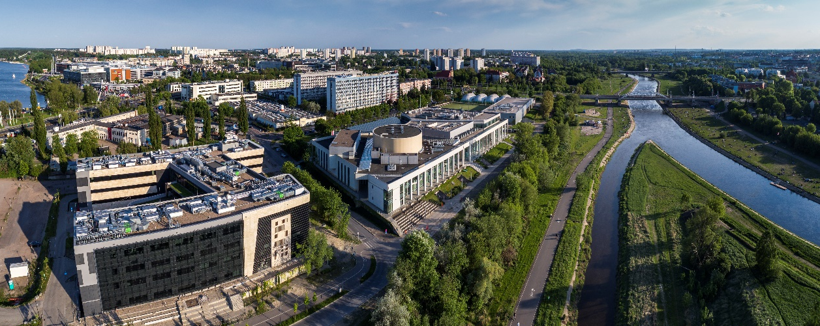
WELCOME TO
POZNAN UNIVERSITY OF TECHNOLOGY

Slide 3
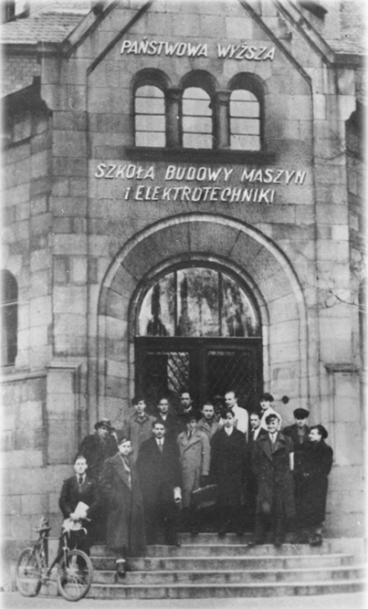
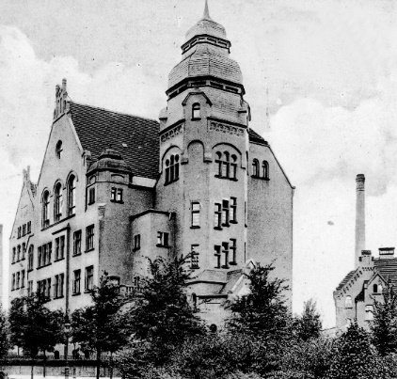

Poznan University of Technology (PUT) was established
in 1919 as a State Higher School of Mechanical Engineering.
Since 1955 it has been named Poznan University of Technology.
One of the leading technical universities in Poland which has become one of the most recognized landmarks of the region.
Great combination of
tradition & innovation

Slide 4



Slide 5
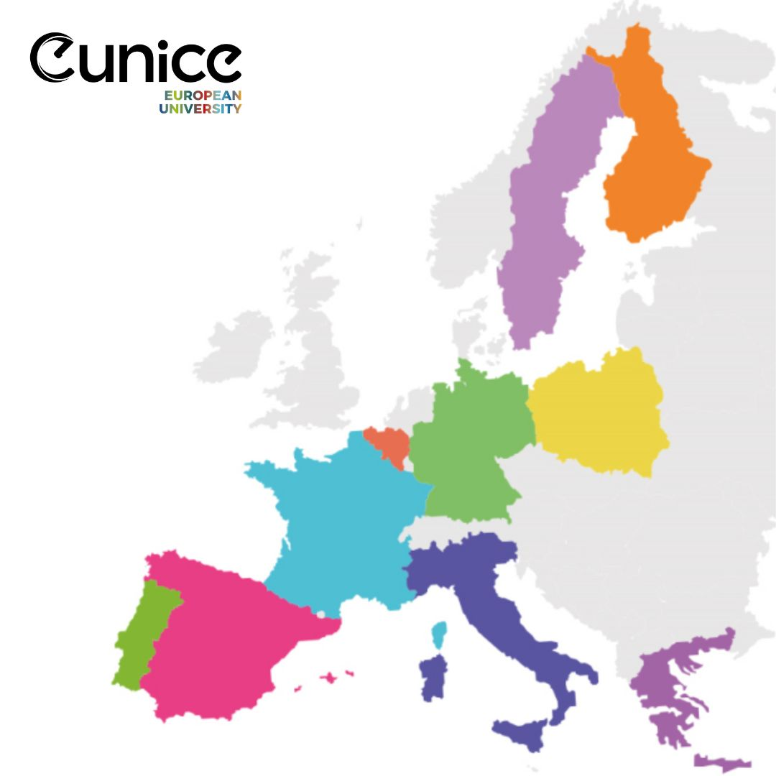

European University for Customised Education
PUT – Poznan University of Technology – leader of EUNICE Alliance
BTU – Brandenburg University of Technology Cottbus-Senftenberg
UMONS – University of Mons
UC – University of Cantabria
UNICT – University of Catania
UPHF – Université Polytechnique Hauts-de-France
UVA – University of Vaasa
UoP – University of the Peloponnese
IPV – Polytechnic Institute of Viseu
KU – Karlstad University
PUT FACULTIES
FACULTY OF ARCHITECTURE
FACULTY OF CIVIL AND TRANSPORT ENGINEERING
FACULTY OF CONTROL, ROBOTICS AND ELECTRICAL ENGINEERING
FACULTY OF COMPUTING AND TELECOMMUNICATIONS
FACULTY OF MATERIALS ENGINEERING AND TECHNICAL PHYSICS
FACULTY OF ENVIRONMENTAL ENGINEERING AND ENERGY
FACULTY OF ENGINEERING MANAGEMENT
FACULTY OF MECHANICAL ENGINEERING
FACULTY OF CHEMICAL TECHNOLOGY
Notes:
5

Slide 6
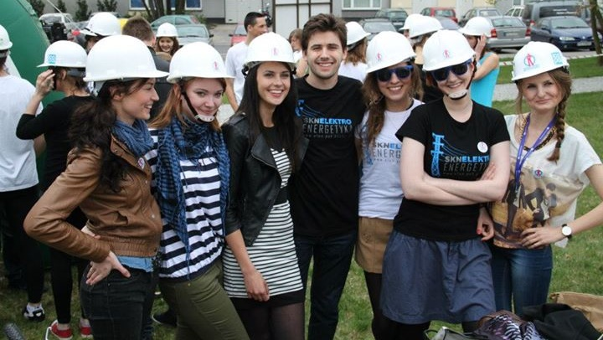
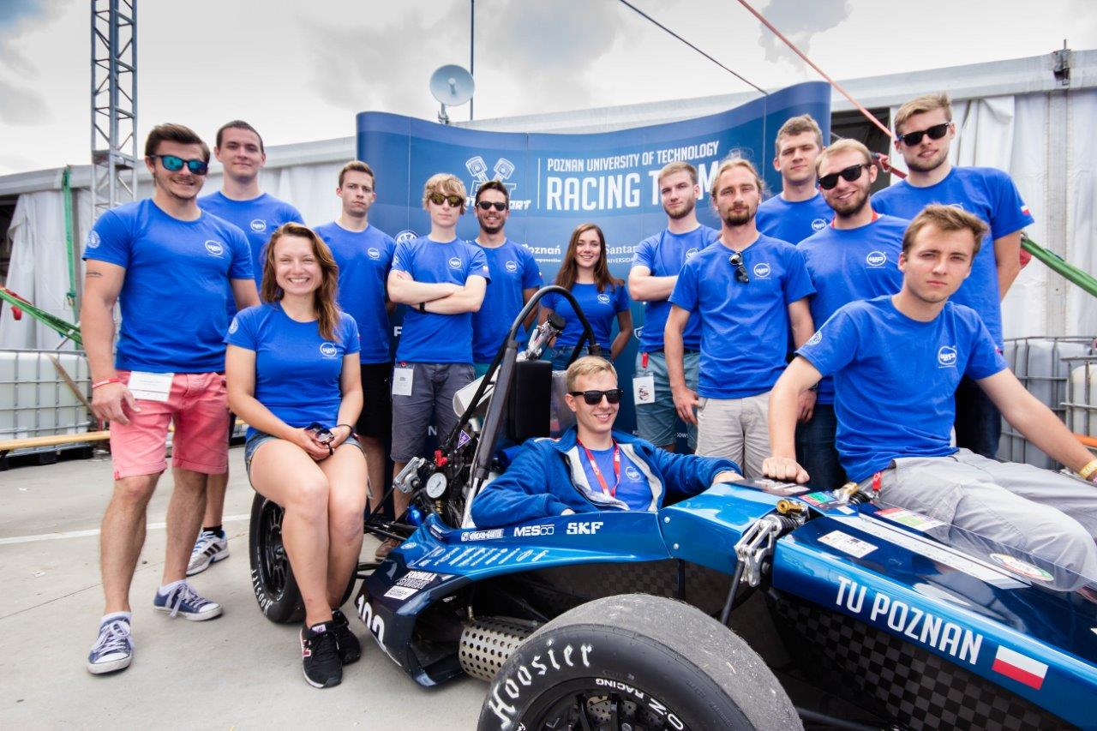
PUT IN NUMBERS
9 faculties
more than 14 thousand students
(more than 1000 of them are international)
more than 40 fields of study
8 BSc programs in English
22 MSc options in English
324 labs
2368 employees
1342 academic staff
more than 2000 places in dormitories

Slide 7




PUT IN RANKINGS
Poznan University of Technology maintained its position (1201-1500) in WUR 2024, achieving 15th place among Polish universities.
WUR 2024 by subject:
Business and Economics (601–800)
Computer Science (801–1000)
Engineering (801–1000)
Physical Sciences (801–1000)
QS WORLD UNIVERSITY RANKINGS 2024.TOP GLOBAL UNIVERSITIES: PUT was among 22 Polish universities classified in the list of the best universities in the world and was ranked 5th among Polish technical universities
47 Researchers from PUT are on the list of the world's
most cited researchers - top 2% list prepared by
Stanford University (in cooperation Elsevier)

Slide 8

PUT FACULTIES
FACULTY OF ARCHITECTURE
FACULTY OF CIVIL AND TRANSPORT ENGINEERING
FACULTY OF CONTROL, ROBOTICS AND ELECTRICAL ENGINEERING
FACULTY OF COMPUTING AND TELECOMMUNICATIONS
FACULTY OF MATERIALS ENGINEERING AND TECHNICAL PHYSICS
FACULTY OF ENVIRONMENTAL ENGINEERING AND ENERGY
FACULTY OF ENGINEERING MANAGEMENT
FACULTY OF MECHANICAL ENGINEERING
FACULTY OF CHEMICAL TECHNOLOGY
Notes:
8

Slide 9
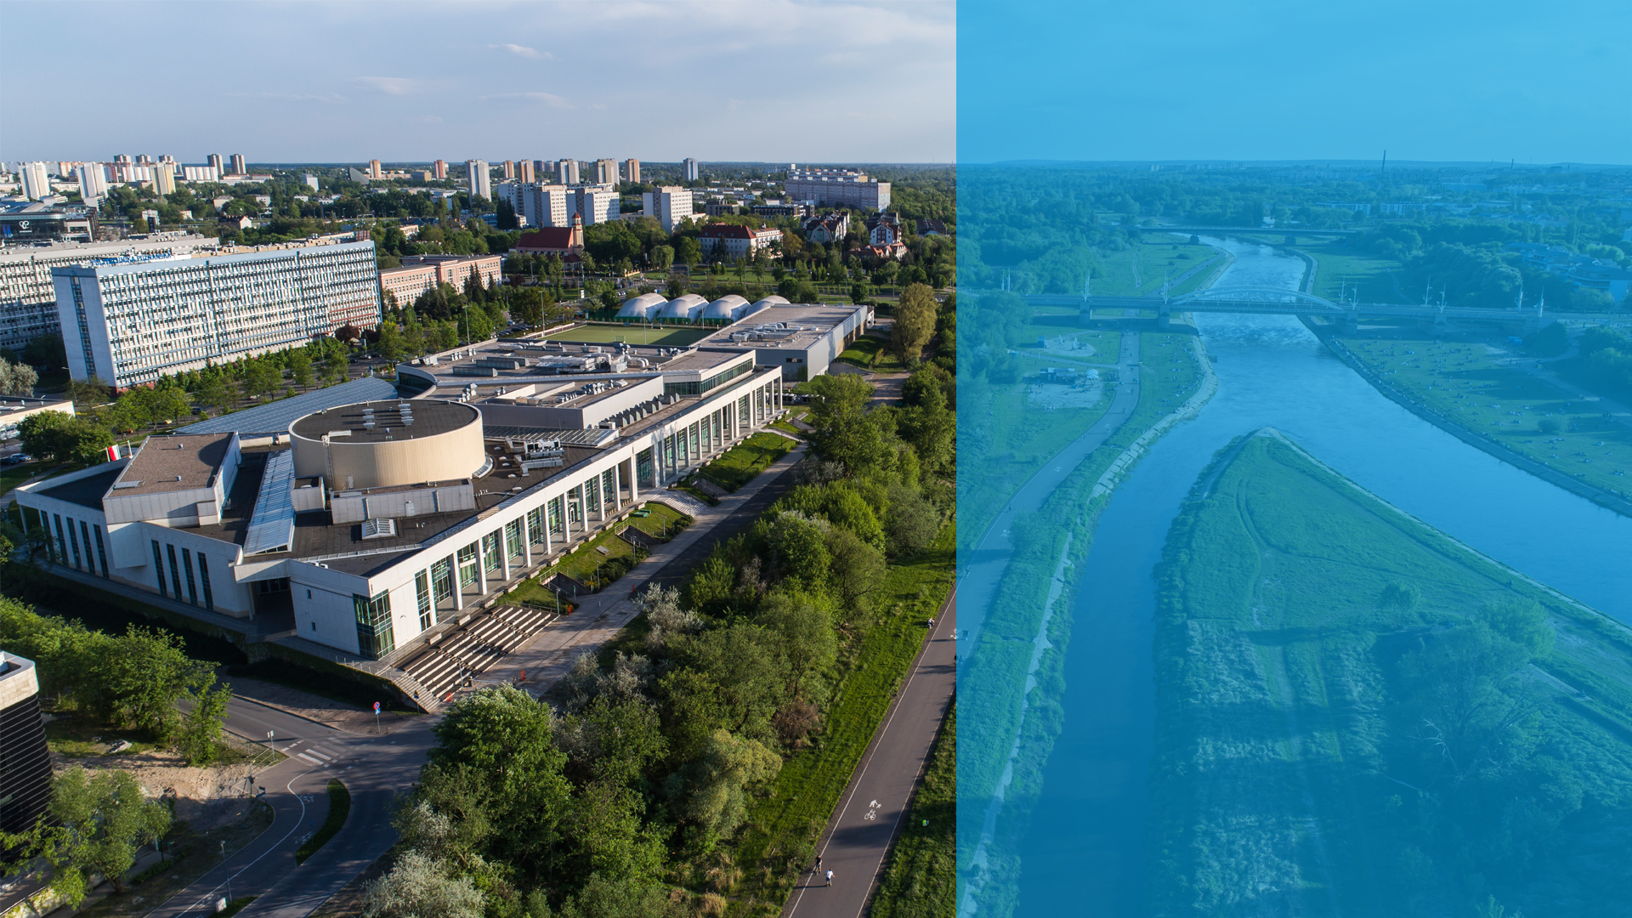
CAMPUS
on the banks of the Warta River
10 minutes from the
Old Market Square
5 minutes to Malta Lake

Slide 10
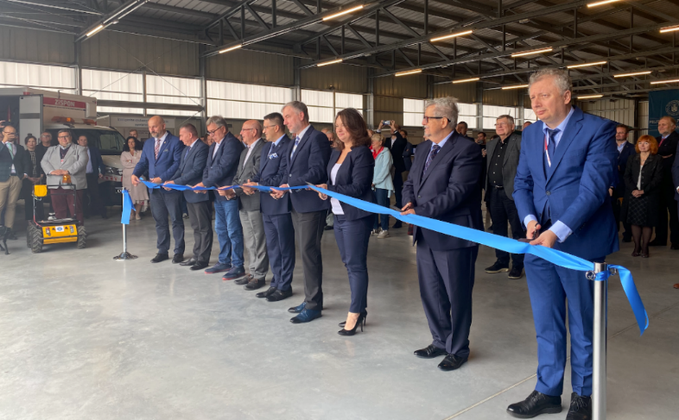
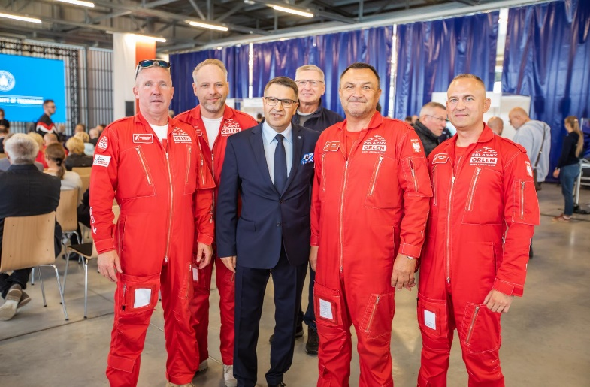
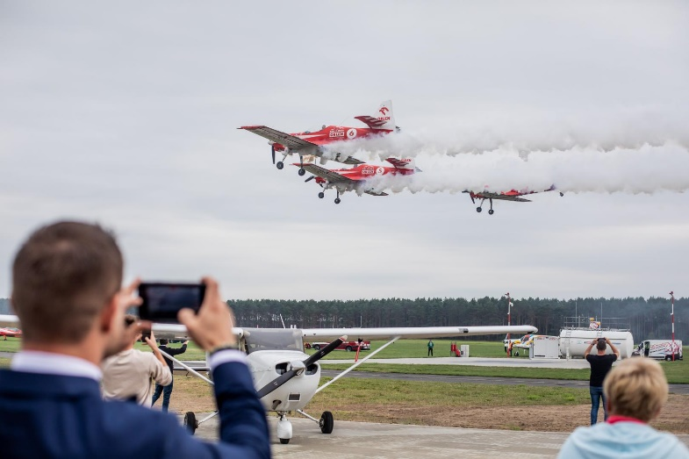
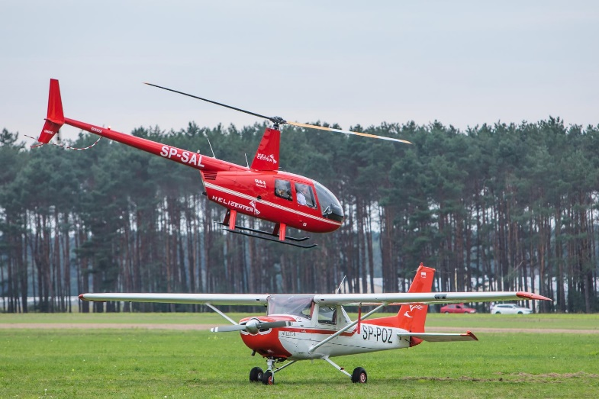
OPENING OF KAKOLEWO CAMPUS
(Sept. 2022)

Slide 11
HIGHER EDUCATION SYSTEM at PUT
c
1ST CYCLE
7 SEMESTERS
(3,5 YEARS)
BEGINING
IN OCTOBER
2ND CYCLE
3-4 SEMESTERS
(1,5-2 YEARS)
BEGINING
IN MARCH/OCTOBER
3RD CYCLE
(4 YEARS)
BEGINING
IN OCTOBER
Notes:
11

Slide 12

Currently PUT offers 8 B.Sc. Programs in English
PROGRAMS IN ENGLISH
+ NEW B.Sc. Program in Biomedical Engineering

Slide 13
and 22 options at M.Sc. level in English (1):
PROGRAMS IN ENGLISH
Civil Engineering - Construction Engineering and Management
Civil Engineering - Structural Engineering
Computing - Cybersecurity
Computing - Software Engineering
Architecture
Product Lifecycle Engineering
Chemical Technology - Composites and Nanomaterials
Electronics and Telecommunications - Information and Communication Technologies
Engineering Management - Managing Enterprise of the Future (+Double degree option with Université Lille 1, France)
Mechanical and Automotive Engineering - Product Engineering

Slide 14
and 22 options at M.Sc. level in English (1):
PROGRAMS IN ENGLISH
Logistics - Logistics Systems
Automatic Control and Robotics - Smart Aerospace and Autonomous Systems
Transport - Sustainable Transport
Green Energy^{new}
Artificial Intelligence
Electrical Engineering - Drive Systems in Industry and Electromobility^{new}
Electrical Engineering - Electrical Systems in Industry and Vehicles^{new}
Electrical Engineering - Lighting Engineering^{new}
Electrical Engineering - Microprocessor Control Systems in Electrical Engineering^{new}
Electrical Engineering - Smart Measurement Systems^{new}
Biomedical Engineering^{new}
Mechatronics^{new}

Slide 15















COOPERATION WITH INDUSTRY

Slide 16
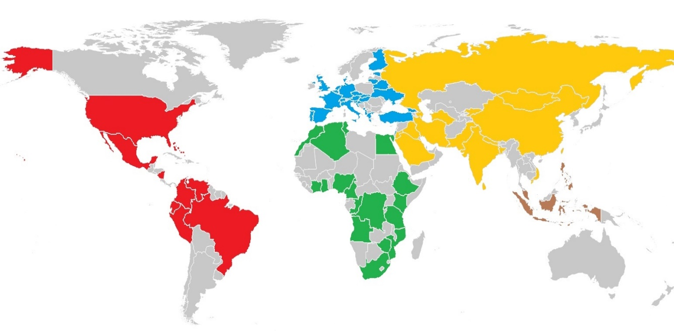


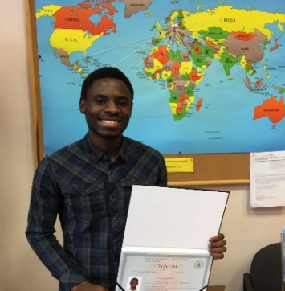
PUT INTERNATIONAL STUDENTS COME
FROM OVER 60 COUNTRIES

Slide 17





INTERCULTURAL EVENTS

Slide 18

Magdalena Zawirska-Wolniewicz
Head of
INTERNATIONAL RELATIONS OFFICE
Piotrowo 5, 60-965 Poznan, Poland
Tel. +48 61 665 35 43
iro@put.poznan.pl

