Slide 2
Faculty of Mechanical Engineering

Slide 3
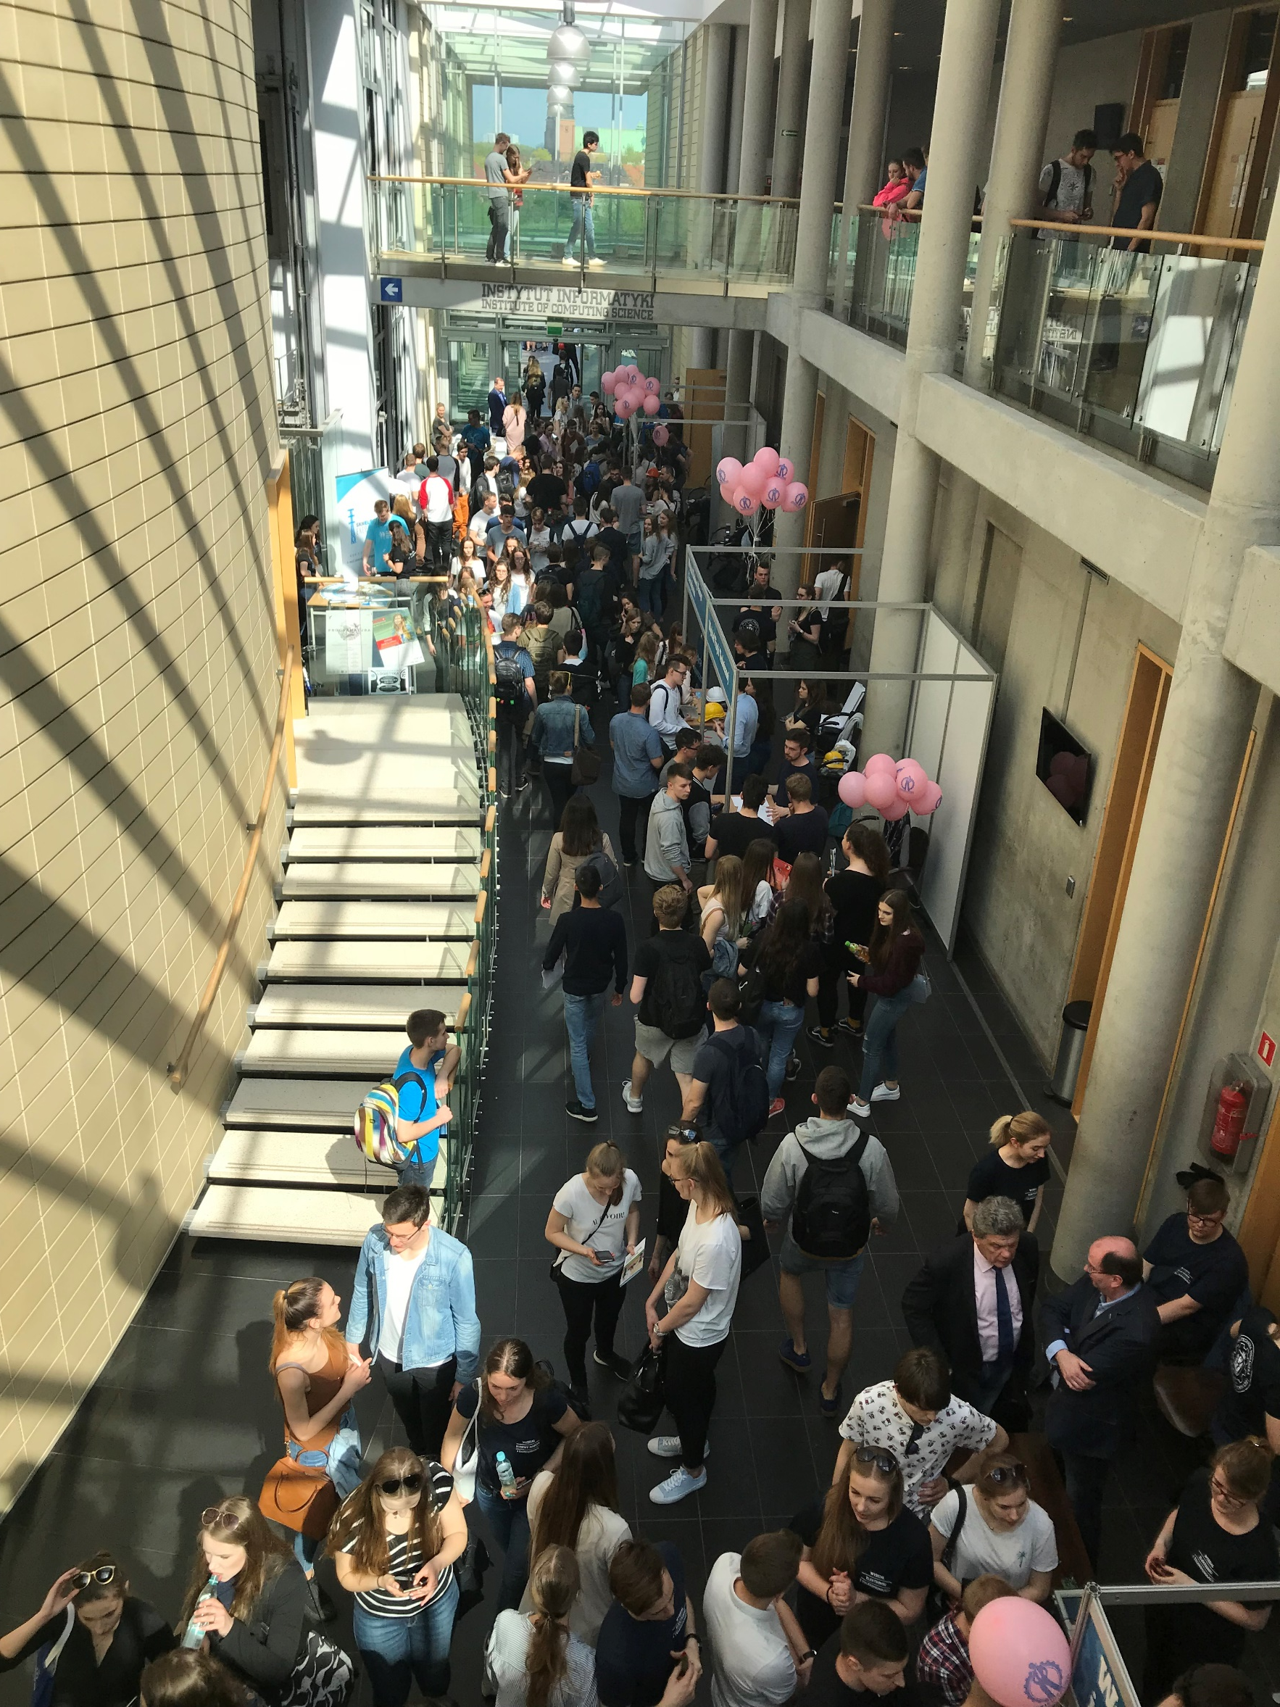
the city of education
The third largest academic and scientific center in Poland*:
26 higher education institutions
almost 130 000 of students
221 students for 1 000 people in Poznan
every year about 25 000 students graduate
8 000 Academic Staff, almost 1 000 of scientists holding the title of professor

Slide 4
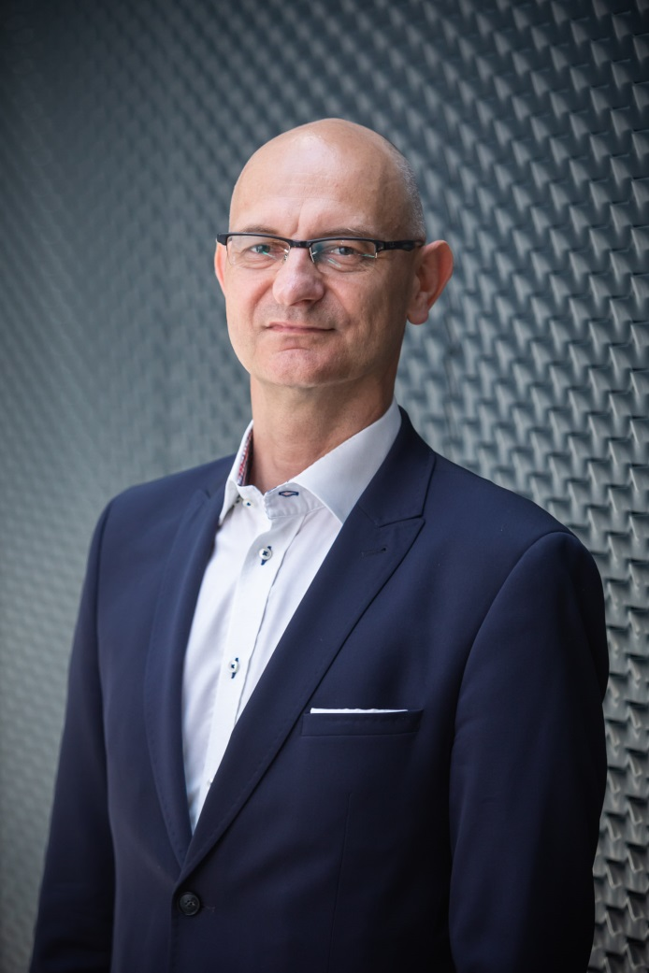
Faculty of Mechanical Engineering
prof. Olaf CISZAK
Dean
Faculty of Mechanical Engineering
Poznan University of Technology

Slide 5
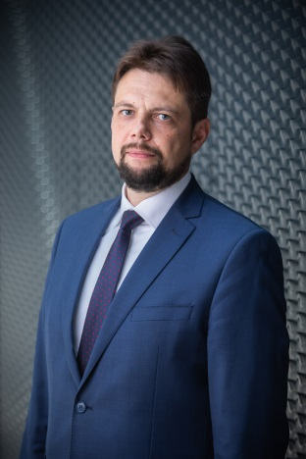
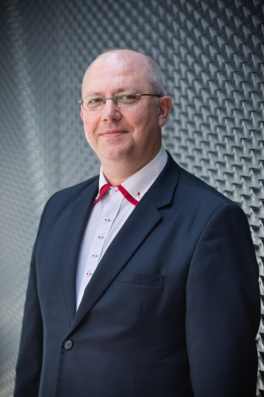
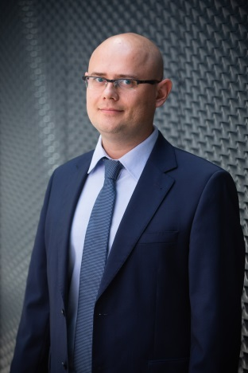
Faculty of Mechanical Engineering
Vice – Dean for Education (part - time studies)
Bartosz Gapiński PhD., DSc. Professor
Vice – Dean for Education (full – time studies)
Krzysztof Grześkowiak PhD.
Vice - Dean for cooperation with industry
Justyna Trojanowska PhD.
Vice – Dean for Science
Szymon Wojciechowski PhD., DSc. Professor

Slide 6
Faculty of Mechanical Engineering
The State
Higher School of
Mechanical Engineering
– 1919
Presently - the Rector’s office.

Slide 7
Faculty of Mechanical Engineering
The oldest – above 100 years
„Mother” for many other Faculties
About 24 000 graduates
About 2 500 students
About 50 PhD students
150 academic staff

Slide 8
Faculty of Mechanical Engineering
Fields of study
Bachelor & Master courses:
Mechanical Engineering
Management and Production Engineering
Mechatronics
Biomedical Engineering
Product Lifecycle Engineering (PLE)

Slide 9
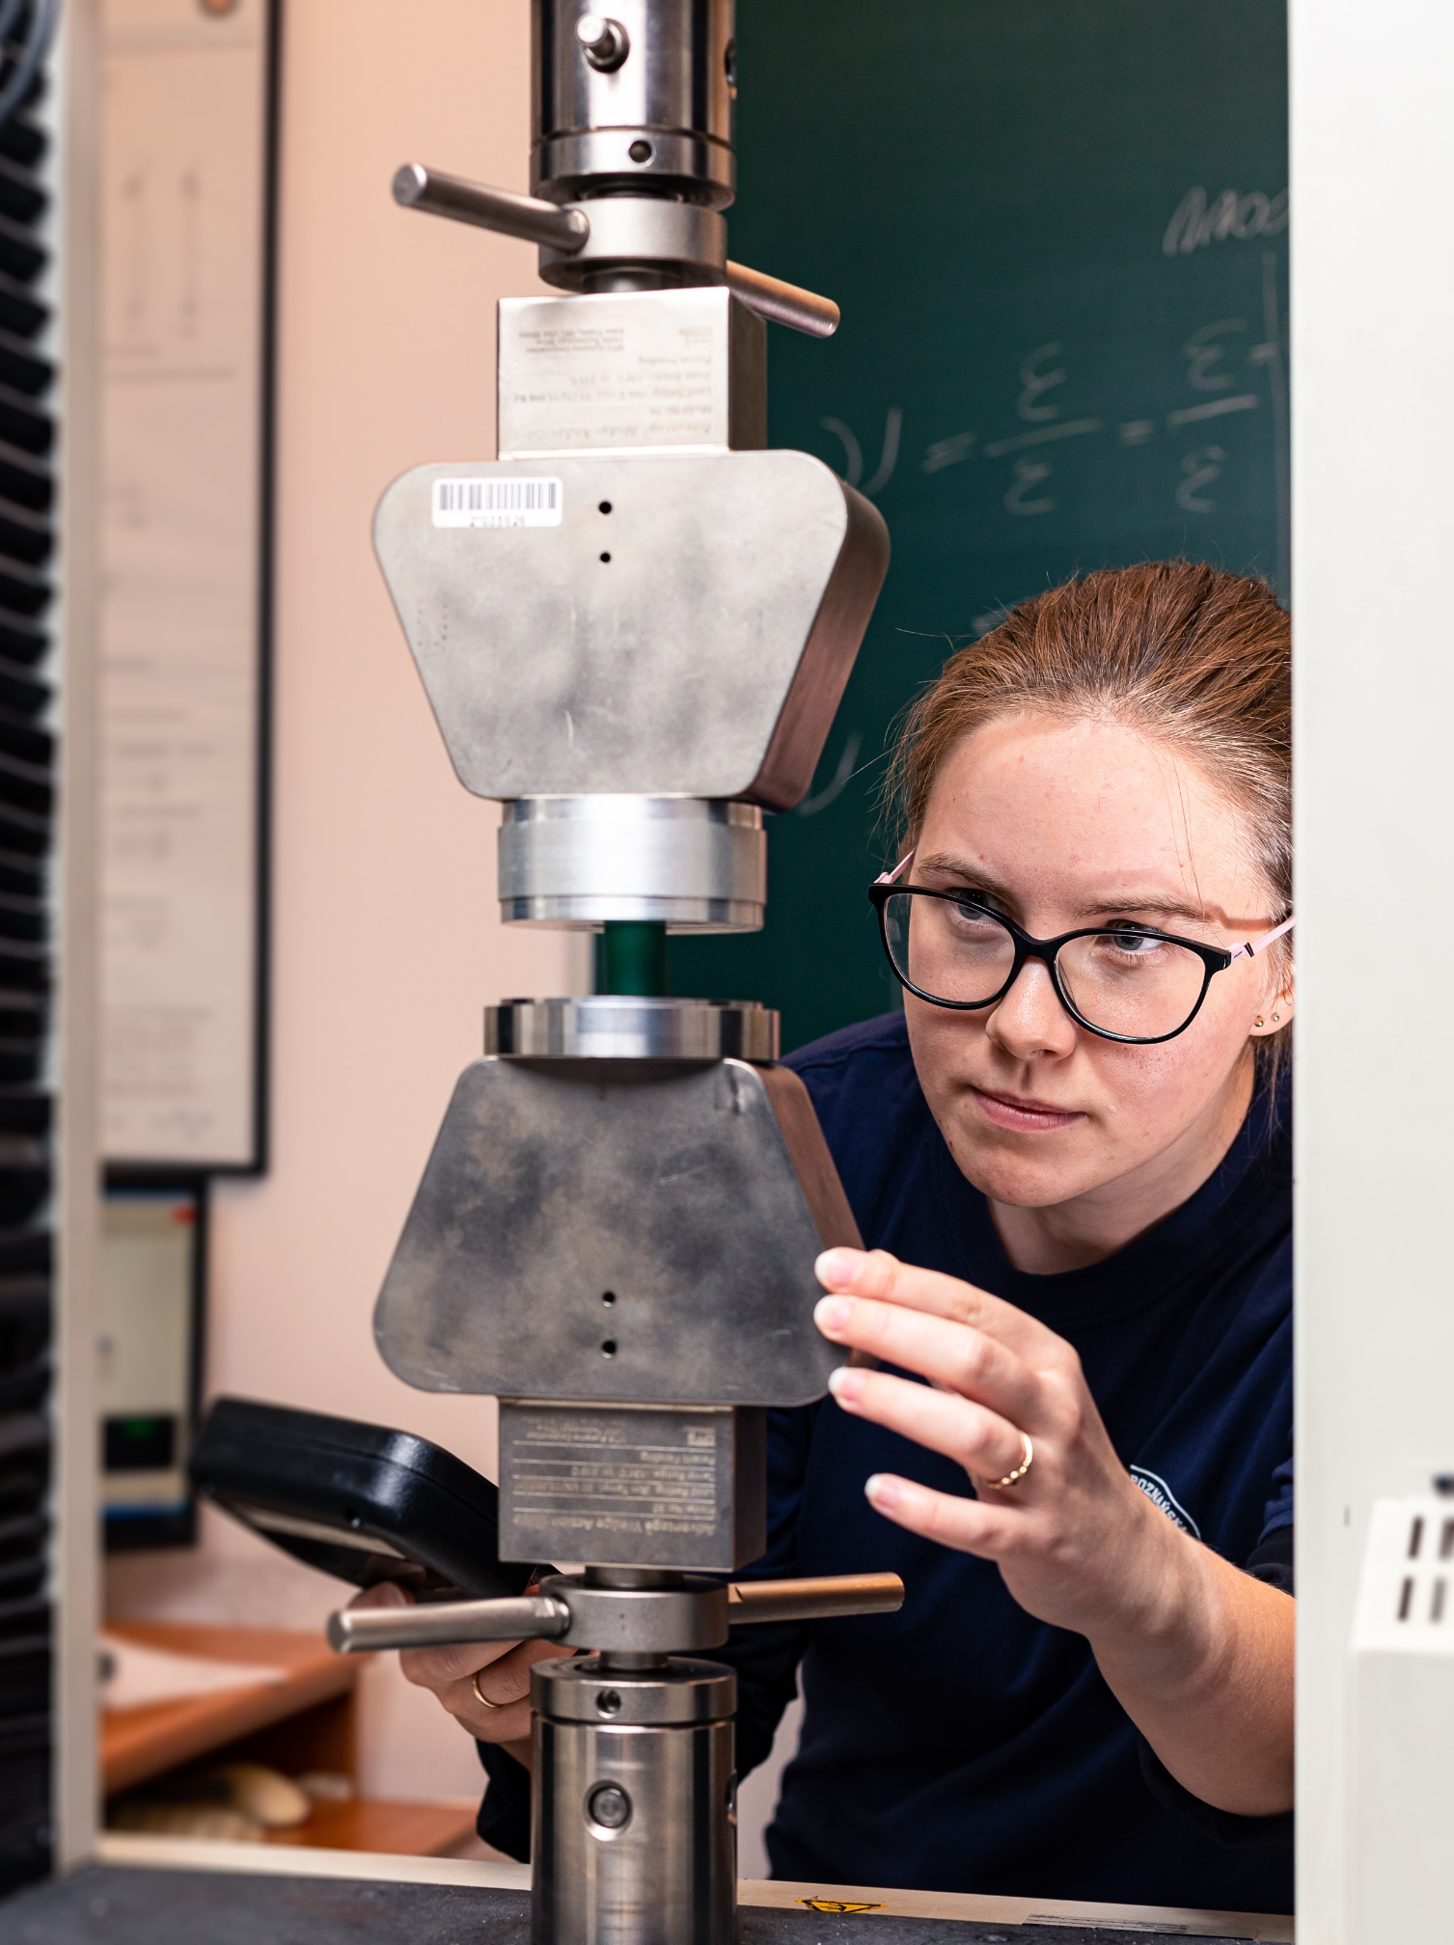
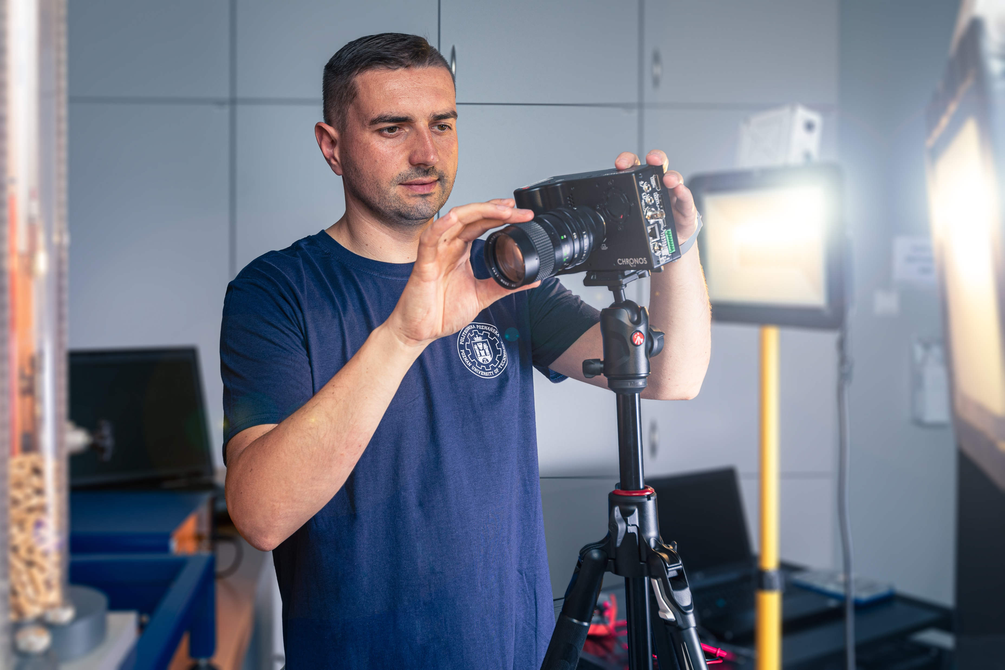
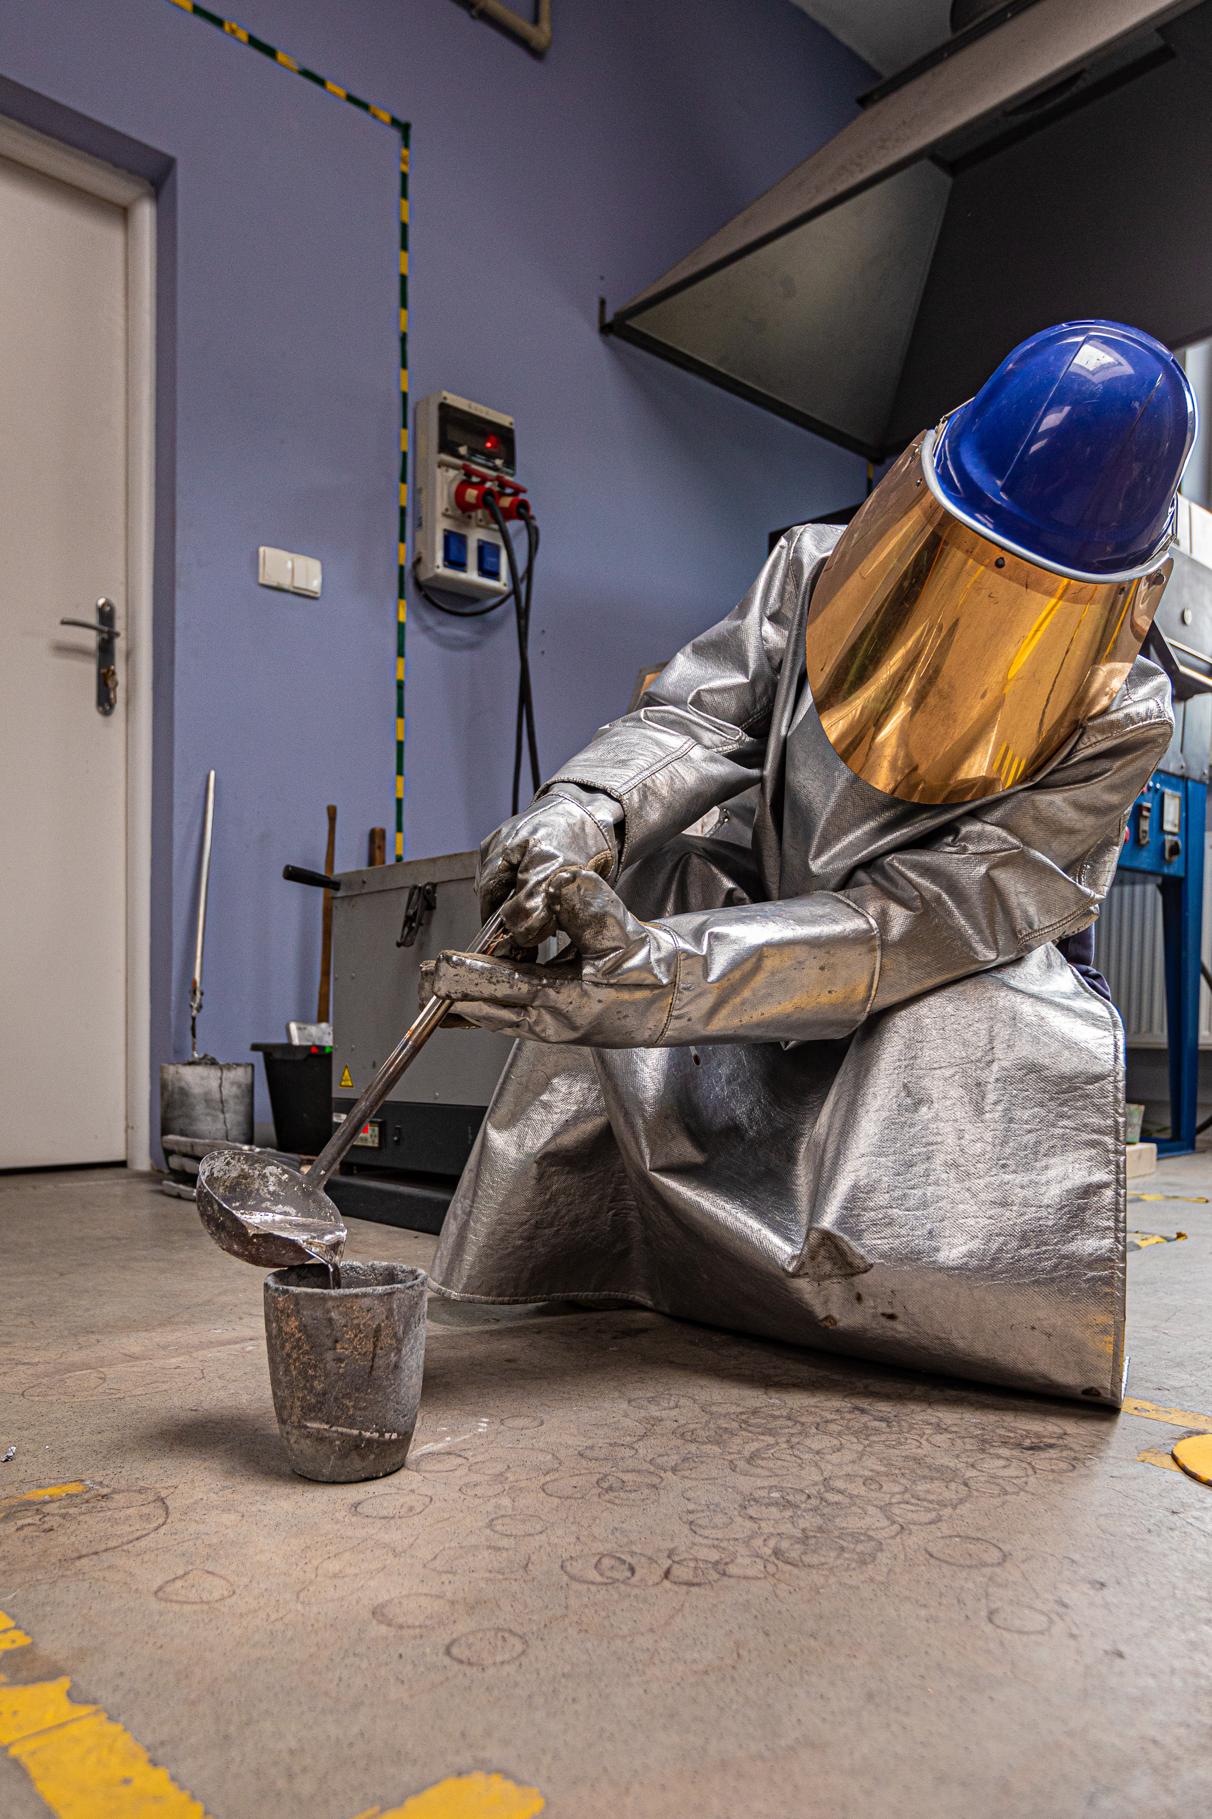
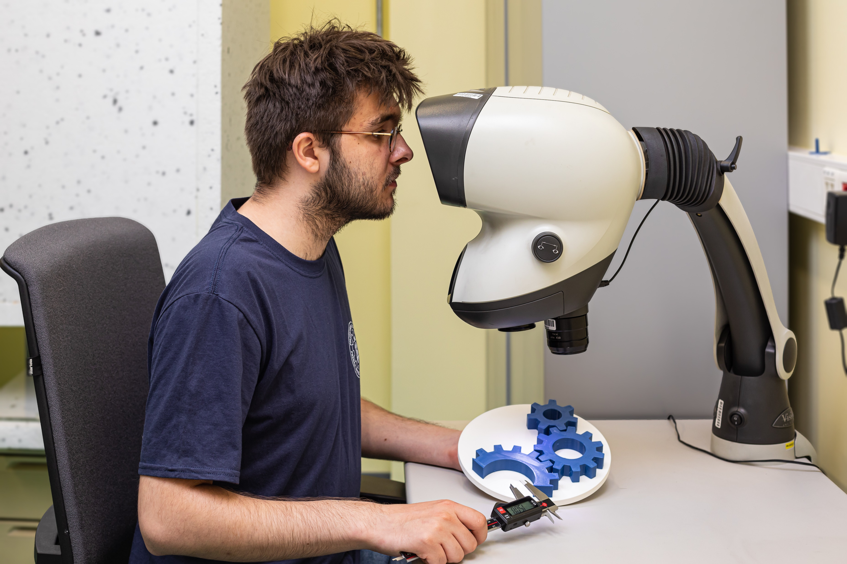
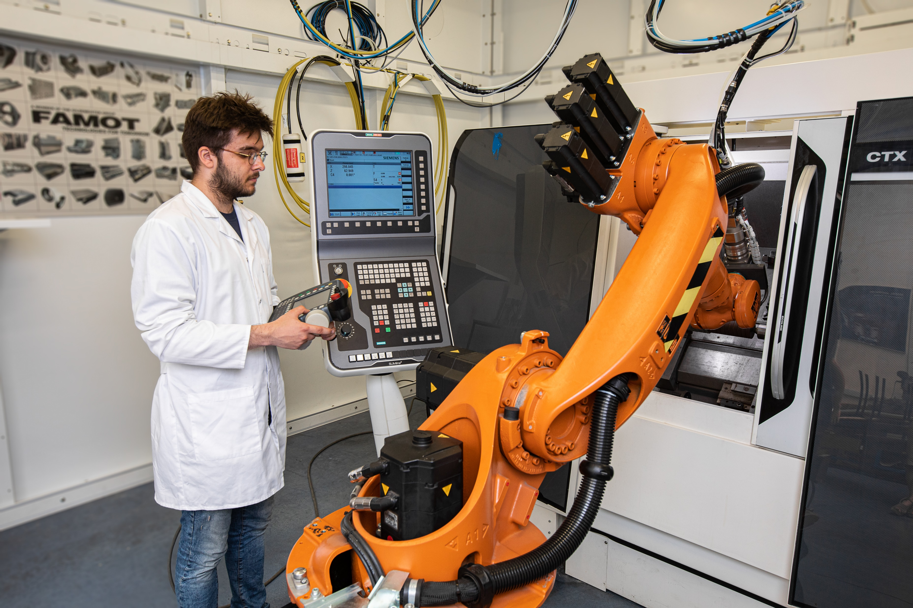
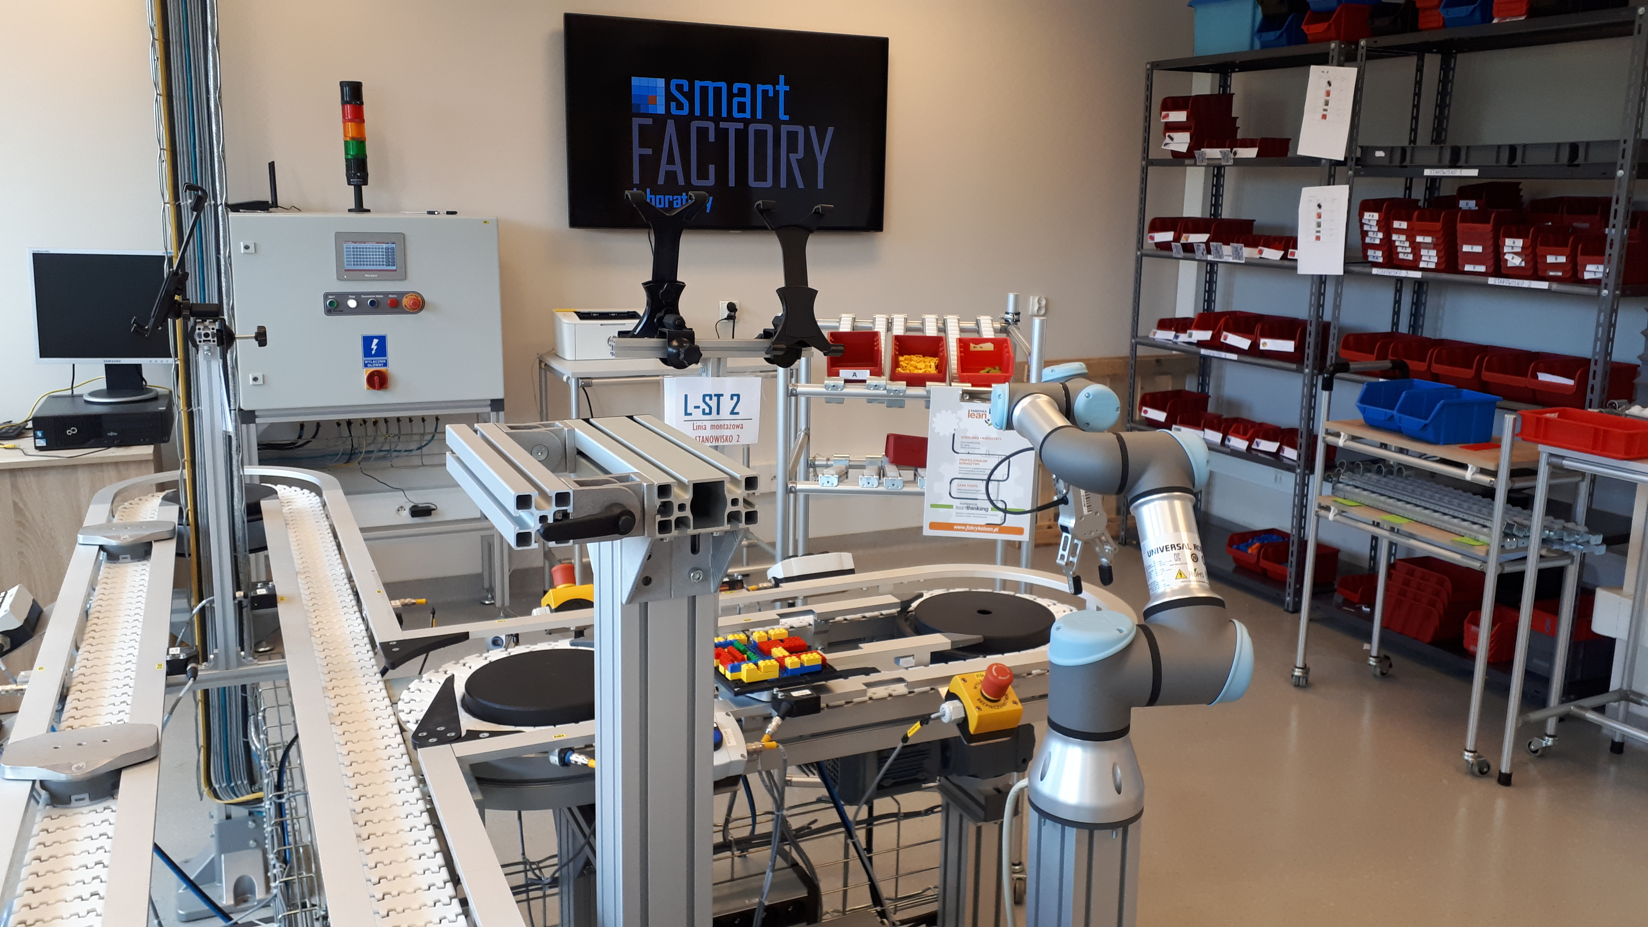
Faculty of Mechanical Engineering
Institutes
FME
Applied Mechanics
Mechanical Technology
Machine Design
Materials Technology

Slide 10
Faculty of Mechanical Engineering
A – Scientific Category
Polish Committee for Evaluation of Scientific Units

Slide 11
Poznan University of Technology
Faculty of Mechanical Engineering
Piotrowo 3 Street; 60-965 Poznan, Poland
tel.: +48 (61) 665-23 60, -23 62
wim@put.poznan.pl, www.wim.put.poznan.pl

