Slide 1
National University of Science and Technology POLITEHNICA Bucharest
Erasmus+ Programme Key Action 2 Cooperation Partnerships
for Higher Education (KA220-HED)
Agreement number 2023-1-RO01-KA220-HED-000155412
European Network for Additive Manufacturing in Industrial Design for Ukrainian Context
Assoc. Prof. Dr. Eng. Băilă Diana-Irinel
University POLITEHNICA of Bucharest, Romania
Faculty of Industrial Engineering and Robotics

Slide 2
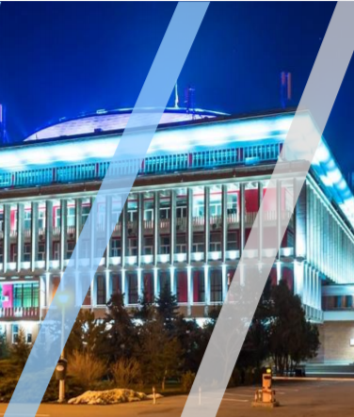
Erasmus+ Programme Key Action 2 Cooperation Partnerships
for Higher Education (KA220-HED)
Agreement number 2023-1-RO01-KA220-HED-000155412
European Network for Additive Manufacturing in Industrial Design for Ukrainian Context
National University of Science and Technology POLITEHNICA Bucharest (UNSTPB) is the oldest and most prestigious engineer school in Romania.
At present the University POLITEHNICA of Bucharest is formed by 15 different faculties.
Most faculties are equipped with 3d printers that used FDM, DLP and SLA technologies.
In the Campus research center of University POLITEHNICA of Bucharest is the best performing 3d bioprinter from Romania.
www.upb.ro

Slide 3
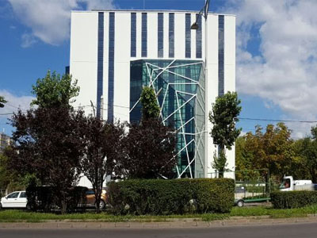
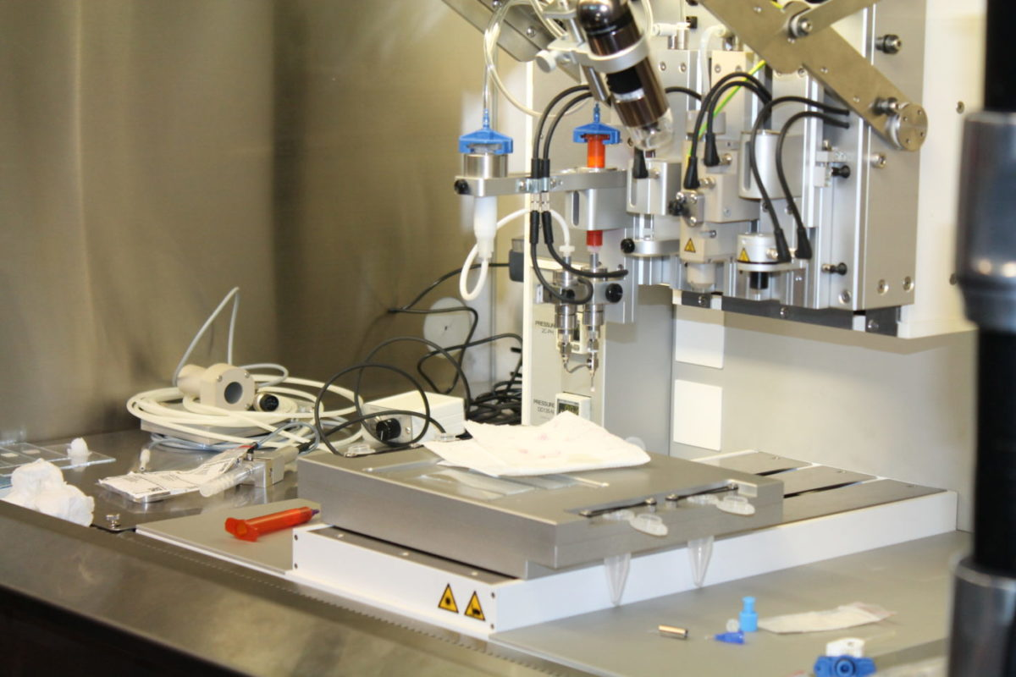
Erasmus+ Programme Key Action 2 Cooperation Partnerships
for Higher Education (KA220-HED)
Agreement number 2023-1-RO01-KA220-HED-000155412
European Network for Additive Manufacturing in Industrial Design for Ukrainian Context
Firma ZSpot Media – RegenHU 3D Discovery
https://www.bioprintere.ro/bioimprimanta-3d-performanta-universitatea-politehnica-bucuresti/
http://campus.pub.ro/website/fluide-nanostructures-and-soft-nanomaterials

Slide 4
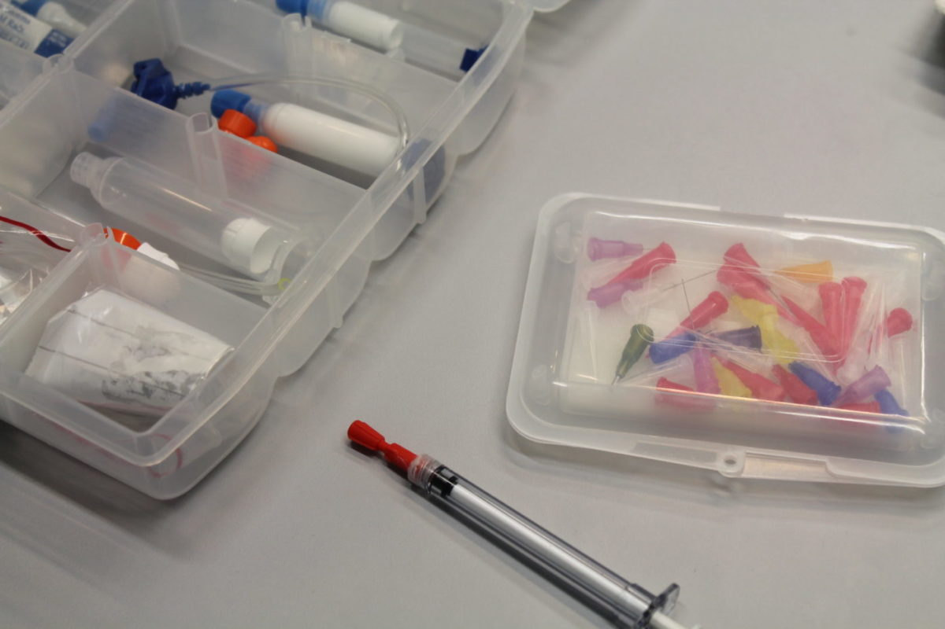
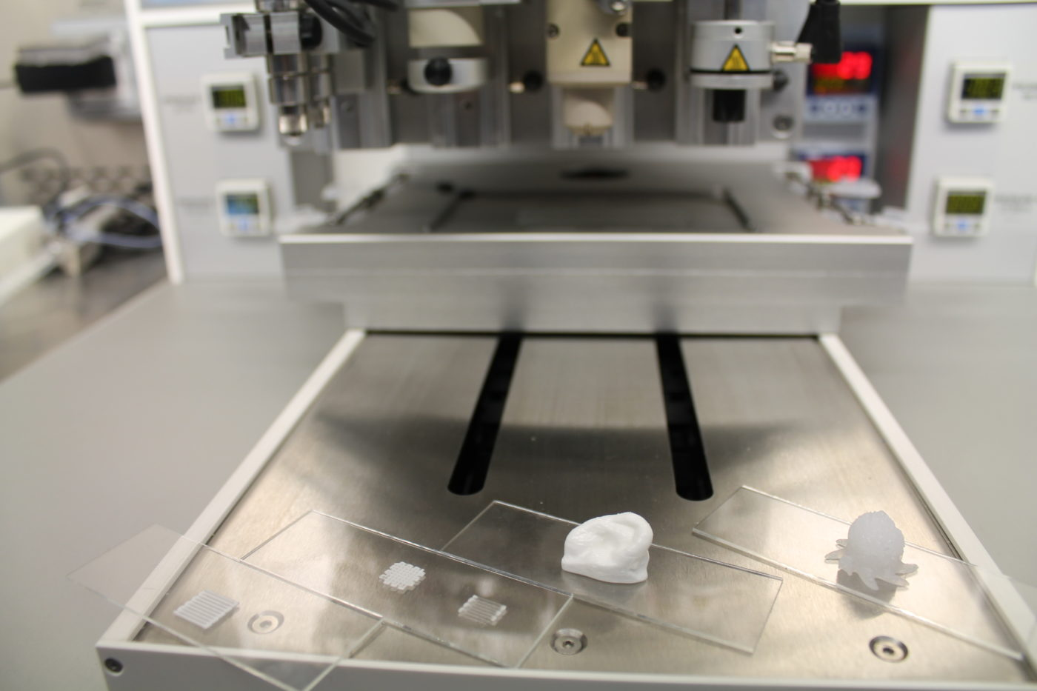
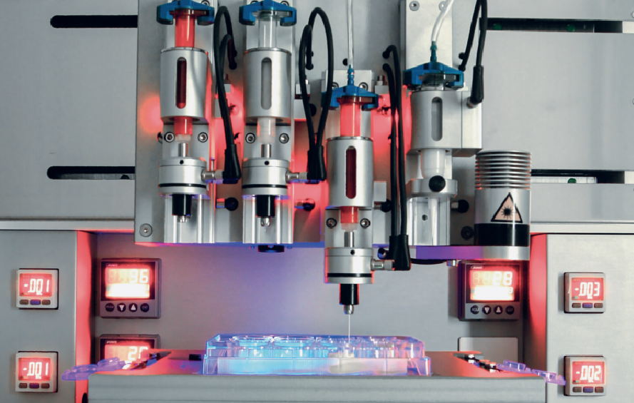
Erasmus+ Programme Key Action 2 Cooperation Partnerships
for Higher Education (KA220-HED)
Agreement number 2023-1-RO01-KA220-HED-000155412
European Network for Additive Manufacturing in Industrial Design for Ukrainian Context
Instruments, objects printed, 5 heads for bioprinting
https://www.bioprintere.ro/bioimprimanta-3d-performanta-universitatea-politehnica-bucuresti/

Slide 5
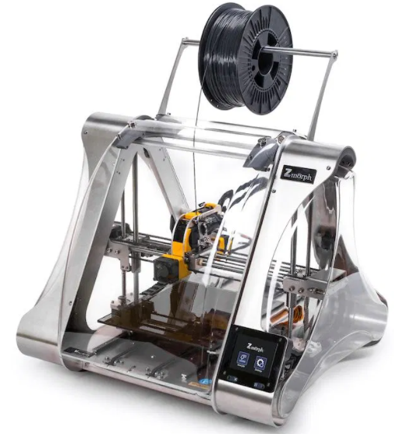
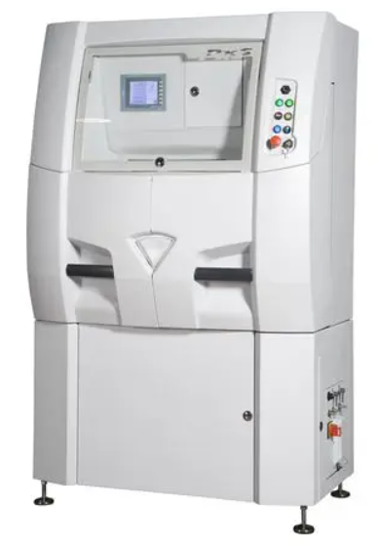
Erasmus+ Programme Key Action 2 Cooperation Partnerships
for Higher Education (KA220-HED)
Agreement number 2023-1-RO01-KA220-HED-000155412
European Network for Additive Manufacturing in Industrial Design for Ukrainian Context
3D Printers that will be used in EMERALD Project - University POLITEHNICA of Bucharest
Phenix Systems – PXS&PXM
- DMLS (Direct Metal Laser Sintering) – collaborating company)
Photocentric Liquid Crystal
- DLP (Digital Light Processing)
Hybrid 3D Printer Zmorph 2.0 SX Full SET
- FDM (Fused Deposition Modeling)

Slide 6
Erasmus+ Programme Key Action 2 Cooperation Partnerships
for Higher Education (KA220-HED)
Agreement number 2023-1-RO01-KA220-HED-000155412
European Network for Additive Manufacturing in Industrial Design for Ukrainian Context
Kick off Meeting – Transnational Project Meeting TPM1 –
UNSTPB Bucharest, 27-29 nov 2023
The dissemination of the event on the website:
https://upb.ro/unstpb-anunta-lansarea-proiectului-international-erasmus-european-network-for-additive-manufacturing-in-industrial-design-for-ukrainian-context-amaze/

Slide 7
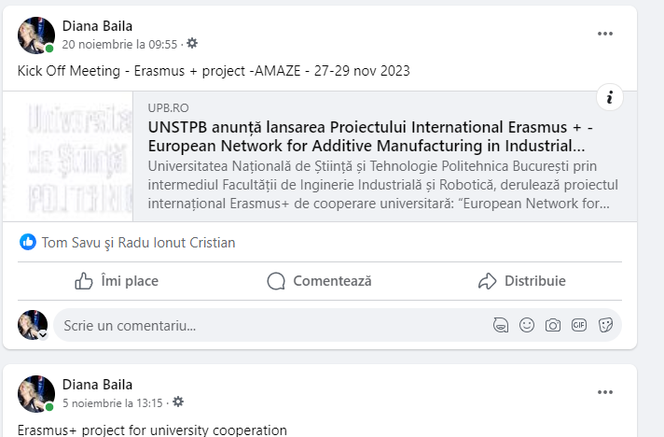
Erasmus+ Programme Key Action 2 Cooperation Partnerships
for Higher Education (KA220-HED)
Agreement number 2023-1-RO01-KA220-HED-000155412
European Network for Additive Manufacturing in Industrial Design for Ukrainian Context
Kick off Meeting – Transnational Project Meeting TPM1 –
UNSTPB Bucharest, 27-29 nov 2023
The dissemination of the event on the facebook:
https://upb.ro/unstpb-anunta-lansarea-proiectului-international-erasmus-european-network-for-additive-manufacturing-in-industrial-design-for-ukrainian-context-amaze/

Slide 8
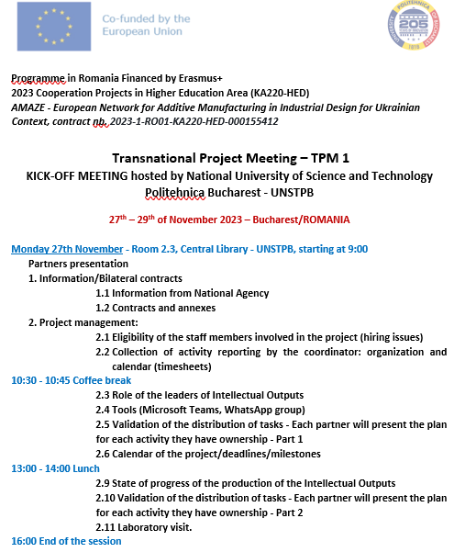
Erasmus+ Programme Key Action 2 Cooperation Partnerships
for Higher Education (KA220-HED)
Agreement number 2023-1-RO01-KA220-HED-000155412
European Network for Additive Manufacturing in Industrial Design for Ukrainian Context
Kick off Meeting – Transnational Project Meeting TPM1 – UNSTPB Bucharest, 27-29 nov 2023
Project Agenda:

Slide 9
Erasmus+ Programme Key Action 2 Cooperation Partnerships
for Higher Education (KA220-HED)
Agreement number 2023-1-RO01-KA220-HED-000155412
European Network for Additive Manufacturing in Industrial Design for Ukrainian Context
Project Partners:
1- National University of Science and Technology Politehnica Bucharest – Project Coordinator: Assoc.Prof. Diana Băilă
2- Yuriy Fedkovych Chernivtsi National University (Ukraine) – Mr. Dean Prof. Igor Fodchuk
3- Poznan University of Technology (Poland) – Project Responsible Mr. Prof. Remigiusz Labudzki
4- Edibon International S.A. (Spain) – Project Responsible Mrs Myrian Judit Bonilla

Slide 10
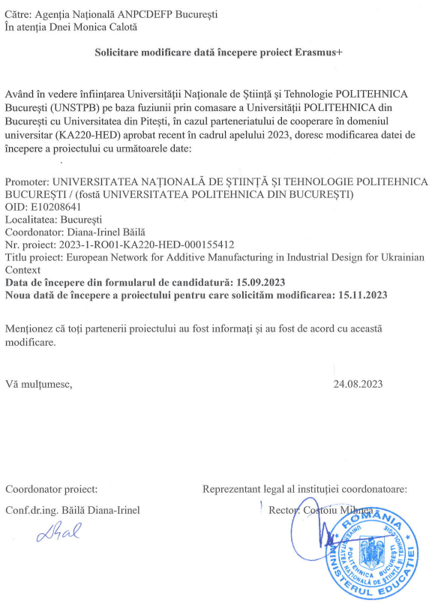
Erasmus+ Programme Key Action 2 Cooperation Partnerships
for Higher Education (KA220-HED)
Agreement number 2023-1-RO01-KA220-HED-000155412
European Network for Additive Manufacturing in Industrial Design for Ukrainian Context
Kick off Meeting – Transnational Project Meeting TPM1 – UNSTPB Bucharest, 27-29 nov 2023
Project Documents:
Request to change the project start date between
15.11.2023-14.11.2024

Slide 11
Erasmus+ Programme Key Action 2 Cooperation Partnerships
for Higher Education (KA220-HED)
Agreement number 2023-1-RO01-KA220-HED-000155412
European Network for Additive Manufacturing in Industrial Design for Ukrainian Context
Kick off Meeting – Transnational Project Meeting TPM1 – UNSTPB Bucharest, 27-29 nov 2023
Project Documents:
1- Mandate forms (between Coordinator and the partners); (if it is the case Power of Attorney);
2- Contract Agreement (between Coordinator and the partners);
3- Project Budget (Annex A);
4- Project submission on ERASMUS+ platform - KA220-HED-9BEBEC9A (Annex B);
5- Funding agreement Erasmus+ between Coordinator and Romanian Agency ANPCDEFP for the project 2023-1-RO01-KA220-HED-000155412 (Annex C);
6- Annex 1 for the project 2023-1-RO01-KA220-HED-000155412 (Annex D).

Slide 12
Erasmus+ Programme Key Action 2 Cooperation Partnerships
for Higher Education (KA220-HED)
Agreement number 2023-1-RO01-KA220-HED-000155412
European Network for Additive Manufacturing in Industrial Design for Ukrainian Context
Kick off Meeting – Transnational Project Meeting TPM1 – UNSTPB Bucharest, 27-29 nov 2023
Project Objectives:

Slide 13
Erasmus+ Programme Key Action 2 Cooperation Partnerships
for Higher Education (KA220-HED)
Agreement number 2023-1-RO01-KA220-HED-000155412
European Network for Additive Manufacturing in Industrial Design for Ukrainian Context
Kick off Meeting – Transnational Project Meeting TPM1 – UNSTPB Bucharest, 27-29 nov 2023
Project Results:

Slide 14
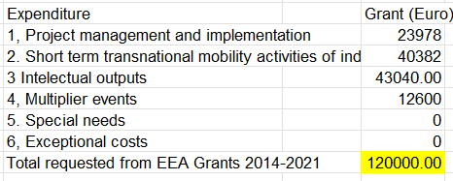
Erasmus+ Programme Key Action 2 Cooperation Partnerships
for Higher Education (KA220-HED)
Agreement number 2023-1-RO01-KA220-HED-000155412
European Network for Additive Manufacturing in Industrial Design for Ukrainian Context
Project Budget

Slide 15
Erasmus+ Programme Key Action 2 Cooperation Partnerships
for Higher Education (KA220-HED)
Agreement number 2023-1-RO01-KA220-HED-000155412
European Network for Additive Manufacturing in Industrial Design for Ukrainian Context
Project Budget – Funding Contract
REPORT |  | PAYMENT
PRE-FUNDING |  | 30 days from entry into force a CONTRACT
1 | 15/11/2023-14/05/2024 | INTERMEDIARY REPORT | 60 days of at the conclusion the period of Report
2 | 15/11/2023-14/11/2024 | FINAL REPORT | 60 days of at the conclusion the period of Report. Final payment. 60 days from receipt the final report
Pre-financing payments |  | guarantees
Pre-financing 1 | 96,000.00 euro (reprezentând 80% din cuantumul maxim al grantului acordat) | N/A

Slide 16
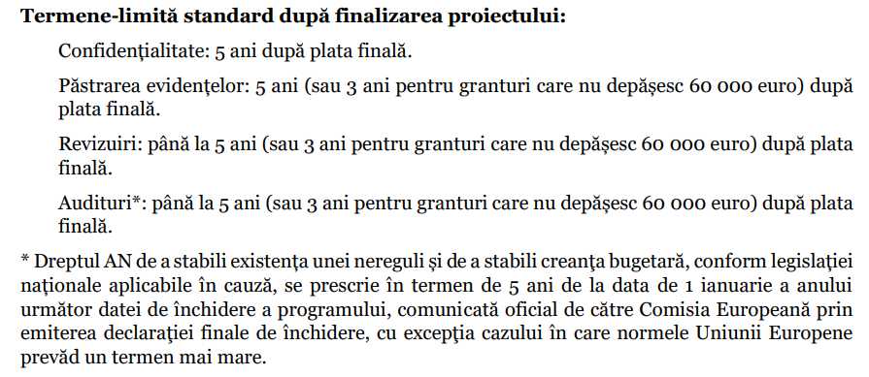
Erasmus+ Programme Key Action 2 Cooperation Partnerships
for Higher Education (KA220-HED)
Agreement number 2023-1-RO01-KA220-HED-000155412
European Network for Additive Manufacturing in Industrial Design for Ukrainian Context
Project Funding Contract
Standard deadlines after project completion:
Confidentiality: 5 years after final payment.
Retention of records: 5 years (or 3 years for grants not exceeding €60,000) after final payment.
Reviews: up to 5 years (or 3 years for grants not exceeding €60,000) after the final payment.
Audits*: up to 5 years (or 3 years for grants not exceeding 60,000 euros) after the final payment.
* The right of the NA to establish the existence of an irregularity and to establish the budget debt, according to the legislation applicable national laws in question, are prescribed within 5 years from January 1 of the year following the closing date of the program, officially communicated by the European Commission via issuing the final closing statement, unless the European Union rules foresee a longer term.

Slide 17
Erasmus+ Programme Key Action 2 Cooperation Partnerships
for Higher Education (KA220-HED)
Agreement number 2023-1-RO01-KA220-HED-000155412
European Network for Additive Manufacturing in Industrial Design for Ukrainian Context
Project Funding Contract
ARTICLE 2 — DEFINITIONS
In this contract, the following terms will be interpreted as follows:
(a) Action — The project that is funded by this contract.
(b) Grant — Funding awarded under this contract.
(c) Participating Entities — Entities participating in the project as beneficiaries, entities
affiliates, associated partners, third-party contributors, subcontractors or recipients
of financial support for third parties.
(d) Participants in Erasmus+ project activities — Erasmus+ participants are those persons fully involved in a project and who may receive part of the grant European Union to cover their participation costs (especially transport and stay).
(e) Beneficiaries (BEN) — Signatories of this contract (either directly or through a form
of adhesion).
(f) Associated Partners (PAs) — Entities participating in the project but not entitled to receive
funding from the project budget.
(g) Procurement — Contracts for the procurement of goods, works, or services that are necessary for carrying out the project (for example: equipment, supplies and office supplies), but which do not are part of the project activities (see Annex 1).
(h) Subcontracting — Contracts for the purchase of goods, works or services that are part of project activities (see Annex 1).
(i) Contributions in kind — Contributions in kind within the meaning of Article 2 paragraph (36) of EU Financial Regulation 2018/1046, namely non-financial resources made available free of charge to the beneficiary by third parties.
(j) Fraud — Fraud within the meaning of Article 3 of Directive (EU) 2017/13712
and of Article 1 of Convention on the protection of the financial interests of the European Communities, drawn up on based on the Council Act of 26 July 19953, as well as any other deliberate deception or with criminal character intended to obtain a financial or personal gain.
(k) Irregularities — Any type of violation (regulatory or contractual) that could had an impact on the financial interests of the EU, including infringements within the meaning of Article 1 paragraph (2) of Regulation (EU) no. 2988/954.
(l) Serious Professional Misconduct — Any type of unacceptable or inappropriate behavior in the exercise of a profession, especially of employees, including serious professional misconduct in the meaning Article 136 paragraph (1), letter (c) of the EU Financial Regulation 2018/1046.

Slide 18
Erasmus+ Programme Key Action 2 Cooperation Partnerships
for Higher Education (KA220-HED)
Agreement number 2023-1-RO01-KA220-HED-000155412
European Network for Additive Manufacturing in Industrial Design for Ukrainian Context
Project Funding Contract
5.5 Budget flexibility
Budgetary flexibility does not apply; the changes made to the estimated budget (breakdown of the amount
lump sum) always requires the conclusion of an additional act (see Article 39).
The amendments by additional act that aim at budget transfers between work packages are
possible only if:
- the work packages concerned are not yet completed (and included in a financial statement); and
- the transfers are justified by the implementation of the action from a technical point of view.

Slide 19
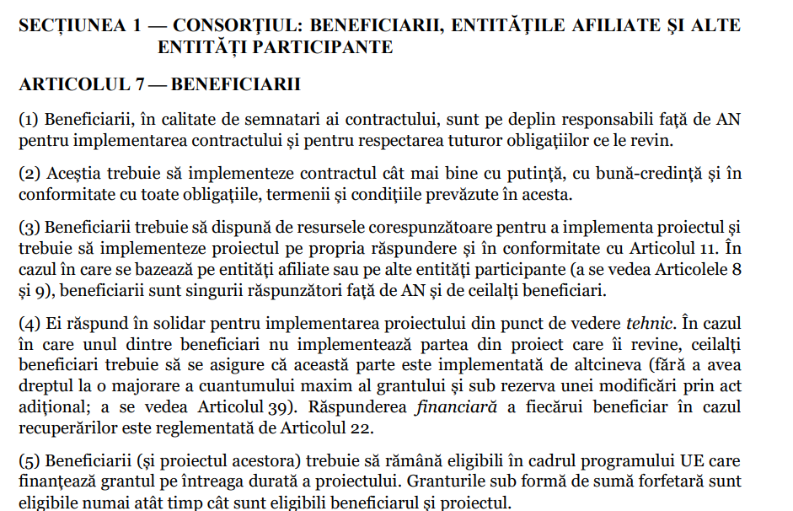
Erasmus+ Programme Key Action 2 Cooperation Partnerships
for Higher Education (KA220-HED)
Agreement number 2023-1-RO01-KA220-HED-000155412
European Network for Additive Manufacturing in Industrial Design for Ukrainian Context
Project Funding Contract
CHAPTER 4 — PROJECT IMPLEMENTATION
SECTION 1 — CONSORTIUM: BENEFICIARIES, AFFILIATED ENTITIES AND OTHERS PARTICIPATING ENTITIES
ARTICLE 7 — BENEFICIARIES
(1) Beneficiaries, as signatories of the contract, are fully responsible towards the NA for the implementation of the contract and for compliance with all their obligations.
(2) They must implement the contract as best as possible, in good faith and in compliance with all obligations, terms and conditions set forth herein.
(3) Beneficiaries must have the appropriate resources to implement the project and must implement the project on its own responsibility and in accordance with Article 11. In if it is based on affiliated entities or other participating entities (see Articles 8 and 9), the beneficiaries are the only ones liable to the NA and the other beneficiaries.
(4) They are jointly responsible for implementing the project from a technical point of view. If
in which one of the beneficiaries does not implement the part of the project that falls to him, the others beneficiaries must ensure that this part is implemented by someone else (without having
the right to an increase in the maximum amount of the grant and subject to an amendment by act
additional; see Article 39). The financial responsibility of each beneficiary in the case recoveries is regulated by Article 22.
(5) Beneficiaries (and their project) must remain eligible under the EU program which finance the grant for the entire duration of the project. Lump sum grants are eligible only as long as the beneficiary and the project are eligible.

Slide 20
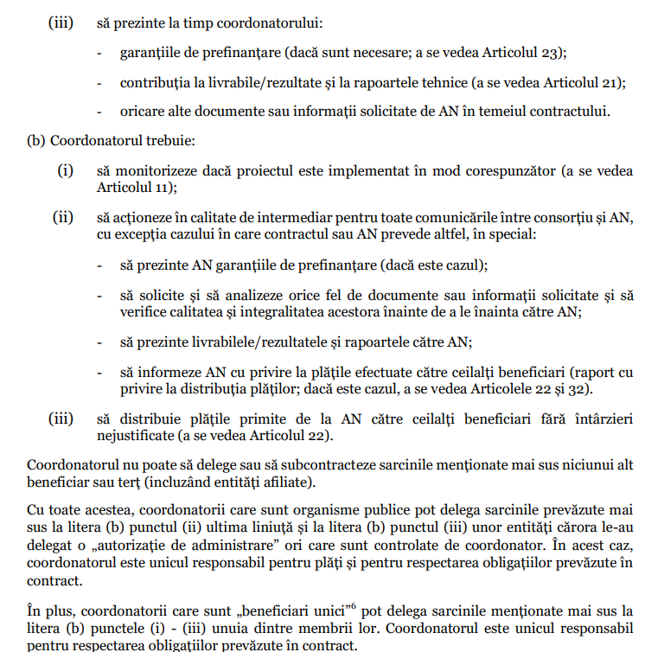
Erasmus+ Programme Key Action 2 Cooperation Partnerships
for Higher Education (KA220-HED)
Agreement number 2023-1-RO01-KA220-HED-000155412
European Network for Additive Manufacturing in Industrial Design for Ukrainian Context
Project Funding Contract

Slide 21
Erasmus+ Programme Key Action 2 Cooperation Partnerships
for Higher Education (KA220-HED)
Agreement number 2023-1-RO01-KA220-HED-000155412
European Network for Additive Manufacturing in Industrial Design for Ukrainian Context
(6) The internal roles and responsibilities of the beneficiaries are divided as
it follows:
(a) Each beneficiary must:
(i) to permanently update the information recorded in the reporting tool and
management of Erasmus+ (see Article 19);
(ii) to immediately inform the NA (and the other beneficiaries) about any event or
situation that may significantly affect or delay implementation the project (see Article 19);
(iii) present to the coordinator in time:
- pre-financing guarantees (if necessary; see Article 23);
- contribution to deliverables/results and technical reports (see Article 21);
- any other documents or information requested by the NA under the contract.
(b) The coordinator must:
(i) to monitor whether the project is properly implemented (see Article 11);
(ii) to act as an intermediary for all communications between the consortium and the NA, unless the contract or AN provides otherwise, in particular:
- to present the pre-financing guarantees to the NA (if applicable);
- to request and analyze any kind of documents or information requested and to check their quality and completeness before submitting them to the NA;
- to present deliverables/results and reports to NA;
- to inform NA about the payments made to the other beneficiaries (in relation to regarding the distribution of payments; if applicable, see Articles 22 and 32).
(iii) to distribute the payments received from the NA to the other beneficiaries without delay unjustified (see Article 22).
The Coordinator may not delegate or subcontract the above tasks to anyone else beneficiary or third party (including affiliated entities).
However, coordinators who are public bodies can delegate the tasks provided for above
above at letter (b) point (ii) the last indent and at letter (b) point (iii) of entities to which they have delegated an "administrative authorization" times that are controlled by the coordinator. In this case, the coordinator is solely responsible for payments and for compliance with the obligations set forth in contract.
In addition, coordinators who are "sole beneficiaries" may delegate the above tasks to letter (b) points (i) - (iii) of one of their members. The coordinator is solely responsible for compliance with the obligations stipulated in the contract.
Beneficiaries must have internal agreements on functioning and coordination to ensure that the project is properly implemented.

Slide 22
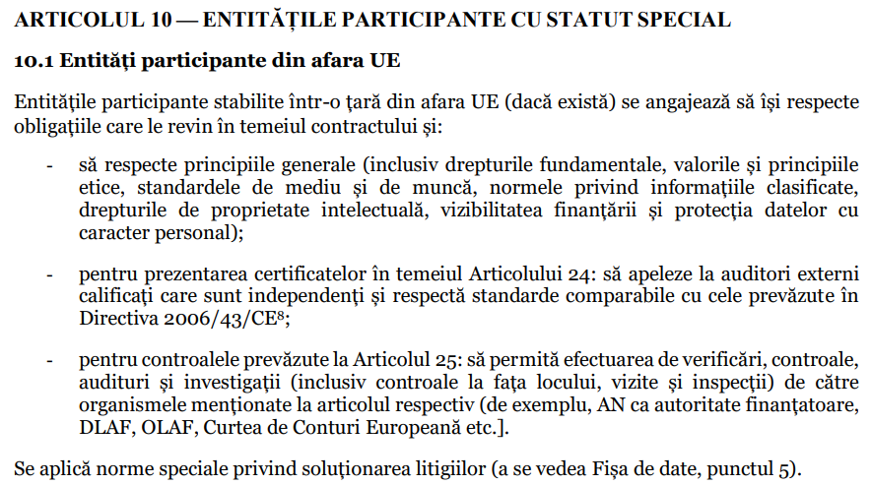
Erasmus+ Programme Key Action 2 Cooperation Partnerships
for Higher Education (KA220-HED)
Agreement number 2023-1-RO01-KA220-HED-000155412
European Network for Additive Manufacturing in Industrial Design for Ukrainian Context
Project Funding Contract
ARTICLE 10 — PARTICIPATING ENTITIES WITH SPECIAL STATUS
10.1 Non-EU Participating Entities
Participating entities established in a non-EU country (if any) undertake to comply with their obligations under the contract and:
- to respect general principles (including fundamental rights, values ​​and principles ethics, environmental and labor standards, norms regarding classified information, intellectual property rights, funding visibility and data protection with personal character);
- for the presentation of certificates pursuant to Article 24: to call on external auditors qualified persons who are independent and comply with standards comparable to those set out in Directive 2006/43/EC8;
- for the controls provided for in Article 25: to allow checks, controls, audits and investigations (including on-site checks, visits and inspections) by the bodies mentioned in the respective article (for example, NA as funding authority, DLAF, OLAF, European Court of Auditors, etc.].
Special dispute resolution rules apply (see Data Sheet, point 5).

Slide 23
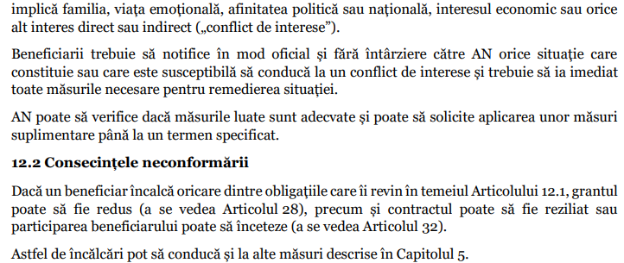
Erasmus+ Programme Key Action 2 Cooperation Partnerships
for Higher Education (KA220-HED)
Agreement number 2023-1-RO01-KA220-HED-000155412
European Network for Additive Manufacturing in Industrial Design for Ukrainian Context
Project Funding Contract
ARTICLE 12 — CONFLICT OF INTEREST
12.1 Conflict of Interest
Beneficiaries must take all necessary measures to prevent any situation in which the impartial and objective implementation of the contract could be compromised for reasons which
it involves family, emotional life, political or national affinity, economic interest or whatever
other direct or indirect interest ("conflict of interest").
Beneficiaries must officially and without delay notify the NA of any situation which constitutes or is likely to lead to a conflict of interest and must take immediate action all necessary measures to remedy the situation.
The NA can check whether the measures taken are adequate and can request the application of certain measures additional up to a specified term.
12.2 Consequences of Non-Compliance
If a grantee breaches any of its obligations under Article 12.1, the grant may be reduced (see Article 28), as well as the contract may be terminated or the beneficiary's participation may cease (see Article 32).
Such violations may also lead to other measures described in Chapter 5.

Slide 24
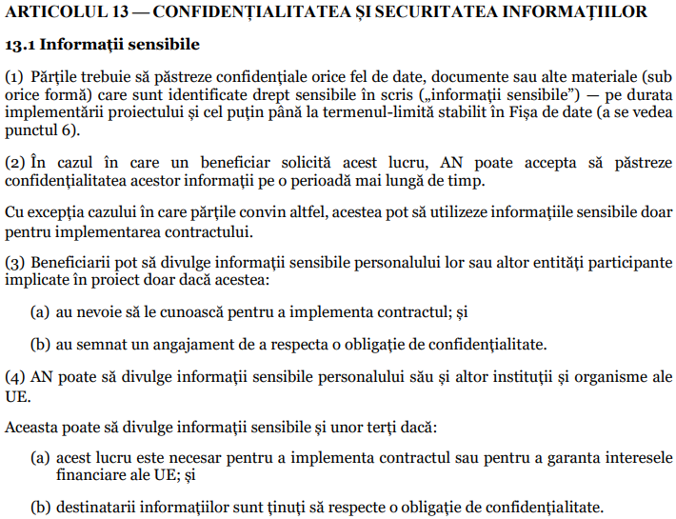
Erasmus+ Programme Key Action 2 Cooperation Partnerships
for Higher Education (KA220-HED)
Agreement number 2023-1-RO01-KA220-HED-000155412
European Network for Additive Manufacturing in Industrial Design for Ukrainian Context
ARTICLE 13 — CONFIDENTIALITY AND SECURITY OF INFORMATION
13.1 Sensitive Information
(1) The parties must keep confidential any kind of data, documents or other materials (sub
any form) that are identified as sensitive in writing ("sensitive information") — for the duration implementation of the project and at least until the deadline set in the Data Sheet (see point 6).
(2) If a beneficiary requests this, the NA may agree to keep the confidentiality of this information over a longer period of time. Unless the parties agree otherwise, they may use the sensitive information only for the implementation of the contract.
(3) Beneficiaries may disclose sensitive information to their staff or other participating entities
involved in the project only if they:
(a) need to know them in order to implement the contract; and
(b) have signed an undertaking to comply with an obligation of confidentiality.
(4) NA may disclose sensitive information to its staff and other institutions and bodies
EU.
It may also disclose sensitive information to third parties if:
(a) this is necessary to implement the contract or to secure interests financial of the EU; and
(b) the recipients of the information are bound by an obligation of confidentiality.
(5) Confidentiality obligations no longer apply if:
(a) the disclosing party agrees to indemnify the other party;
(b) the information becomes publicly available without breach of any confidentiality obligation;
(c) disclosure of sensitive information is required by EU law or legislation
international or national.
(6) Specific rules regarding confidentiality (if applicable) are provided in Annex 2.
Project Funding Contract

Slide 25
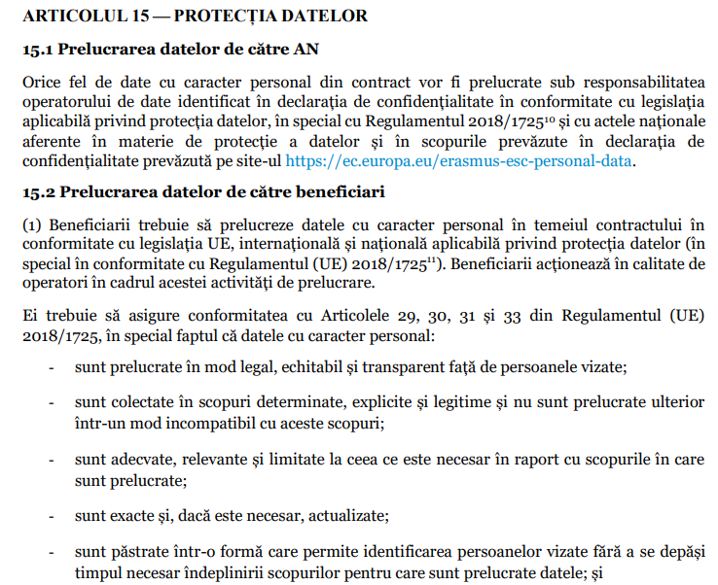
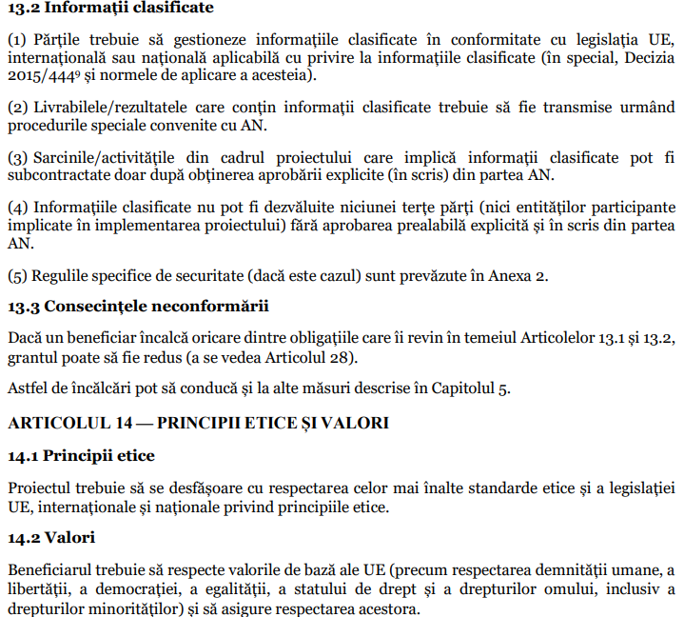
Erasmus+ Programme Key Action 2 Cooperation Partnerships
for Higher Education (KA220-HED)
Agreement number 2023-1-RO01-KA220-HED-000155412
European Network for Additive Manufacturing in Industrial Design for Ukrainian Context
Project Funding Contract

Slide 26
Erasmus+ Programme Key Action 2 Cooperation Partnerships
for Higher Education (KA220-HED)
Agreement number 2023-1-RO01-KA220-HED-000155412
European Network for Additive Manufacturing in Industrial Design for Ukrainian Context
Project Funding Contract
13.2 Classified Information
(1) Parties must manage classified information in accordance with EU legislation,
international or national applicable regarding classified information (in particular, Decision
2015/4449 and its application rules).
(2) Deliverables/results containing classified information must be submitted as follows
the special procedures agreed with the AN.
(3) Project tasks/activities involving classified information may be
subcontracted only after obtaining explicit approval (in writing) from the AN.
(4) Classified information may not be disclosed to any third party (nor participating entities
involved in the implementation of the project) without the explicit prior written approval of the
YEAR.
(5) The specific security rules (if applicable) are provided in Annex 2.
13.3 Consequences of Non-Compliance
If a beneficiary breaches any of its obligations under Articles 13.1 and 13.2, the grant may be reduced (see Article 28).
Such violations may also lead to other measures described in Chapter 5.
ARTICLE 14 — ETHICAL PRINCIPLES AND VALUES
14.1 Ethical principles
The project must be carried out in compliance with the highest ethical standards and legislation
EU, international and national ethical principles.
14.2 Values
The beneficiary must respect the basic values ​​of the EU (such as respect for human dignity, a
freedom, democracy, equality, the rule of law and human rights, including a minority rights) and
ensure their respect.
14.3 Consequences of Non-Compliance
If a beneficiary breaches any of its obligations under Articles 14.1 and 14.2,
the grant may be reduced (see Article 28).
Such violations may also lead to other measures described in Chapter 5.

Slide 27
Erasmus+ Programme Key Action 2 Cooperation Partnerships
for Higher Education (KA220-HED)
Agreement number 2023-1-RO01-KA220-HED-000155412
European Network for Additive Manufacturing in Industrial Design for Ukrainian Context
Project Funding Contract
ARTICLE 15 — DATA PROTECTION
15.1 Data processing by AN
Any kind of personal data from the contract will be processed under responsibility
to the data controller identified in the privacy statement in accordance with the law
applicable data protection, in particular Regulation 2018/172510 and national acts
related to data protection and for the purposes set out in the declaration of
privacy provided on the website https://ec.europa.eu/erasmus-esc-personal-data.
15.2 Data processing by beneficiaries
(1) Beneficiaries must process personal data pursuant to the contract in
in accordance with applicable EU, international and national data protection legislation (art
especially in accordance with Regulation (EU) 2018/172511). Beneficiaries act as operators within this processing activity.
They must ensure compliance with Articles 29, 30, 31 and 33 of Regulation (EU) 2018/1725, in particular the fact that personal data:
- are processed in a legal, fair and transparent manner towards the persons concerned;
- are collected for specific, explicit and legitimate purposes and are not subsequently processed
in a manner incompatible with these purposes;
- are adequate, relevant and limited to what is necessary in relation to the purposes for which
are processed;
- are accurate and, if necessary, updated;
- they are kept in a form that allows the identification of the persons concerned without exceeding each other the time required to fulfill the purposes for which the data are processed; and
- are processed in a way that ensures adequate data security.
(2) Beneficiaries can grant their staff access to personal data only if this is strictly necessary for the implementation, management and monitoring of the contract. Beneficiaries must ensure that staff are bound by confidentiality.
(3) Beneficiaries must inform the data subjects about the data processing and inform them provide the privacy statement available at https://ec.europa.eu/erasmus-esc personal-data.
15.3 Consequences of Non-Compliance
If a grantee breaches any of its obligations under Article 15.2, the grant may be reduced (see Article 28).
Such violations may also lead to other measures described in Chapter 5.

Slide 28
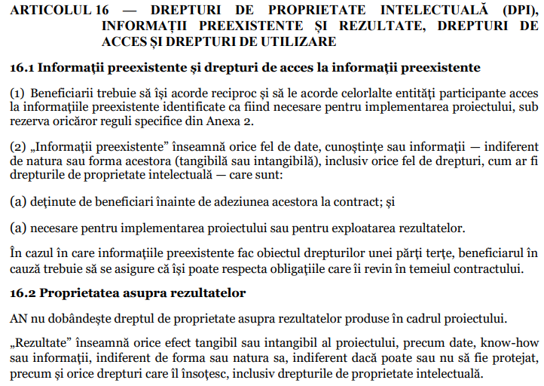
Erasmus+ Programme Key Action 2 Cooperation Partnerships
for Higher Education (KA220-HED)
Agreement number 2023-1-RO01-KA220-HED-000155412
European Network for Additive Manufacturing in Industrial Design for Ukrainian Context
Project Funding Contract
ARTICLE 16 — INTELLECTUAL PROPERTY RIGHTS (IPR), PRE-EXISTING INFORMATION AND RESULTS, RIGHTS OF ACCESS AND USE RIGHTS
16.1 Pre-Existing Information and Rights of Access to Pre-Existing Information
(1) Beneficiaries must grant each other and other participating entities access
to the pre-existing information identified as necessary for the implementation of the project, under subject to any specific rules in Schedule 2.
(2) "Prior-existing information" means any kind of data, knowledge or information — whatever of their nature or form (tangible or intangible), including any kind of rights, such as intellectual property rights — which are:
(a) owned by the beneficiaries before their adhesion to the contract; and
(b) necessary for the implementation of the project or for the exploitation of the results.
If the pre-existing information is subject to the rights of a third party, the beneficiary in
case must ensure that it can fulfill its obligations under the contract.
16.2 Ownership of Results
AN does not acquire ownership rights over the results produced within the project.
"Results" means any tangible or intangible effect of the project, such as data, know-how or information, regardless of its form or nature, whether or not it can be protected, as well as any accompanying rights, including intellectual property rights.

Slide 29
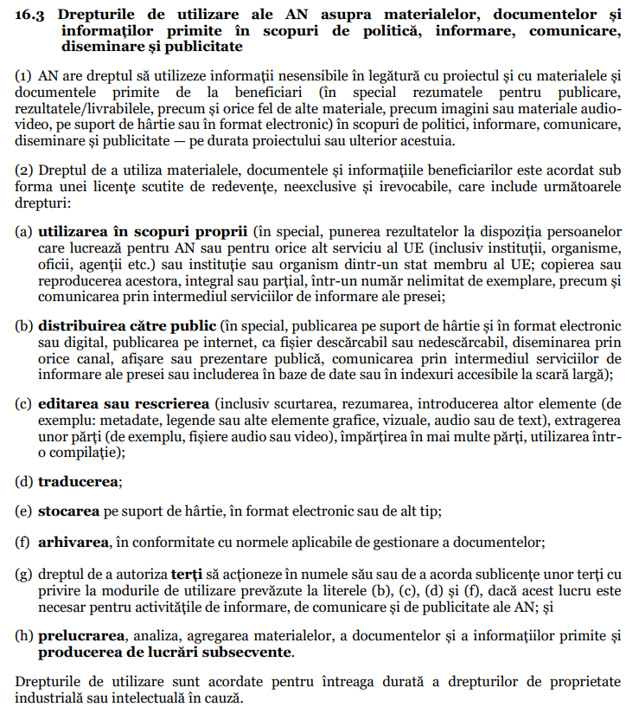
Erasmus+ Programme Key Action 2 Cooperation Partnerships
for Higher Education (KA220-HED)
Agreement number 2023-1-RO01-KA220-HED-000155412
European Network for Additive Manufacturing in Industrial Design for Ukrainian Context
16.3 AN's rights of use over materials, documents and information received for policy, information, communication, dissemination and publicity
(1) AN has the right to use non-sensitive information in relation to the project and the materials and documents received from beneficiaries (in particular abstracts for publication,
results/deliverables, as well as any other materials, such as images or audio video materials, on paper or in electronic format) for policy, information, communication,
dissemination and publicity — during or after the project.
(2) The right to use the materials, documents and information of the beneficiaries is granted under
in the form of a royalty-free, non-exclusive and irrevocable license that includes the following
rights:
(a) use for own purposes (in particular, making the results available to individuals
who work for the NA or for any other EU service (including institutions, bodies,
offices, agencies, etc.) or institution or body from an EU member state; its copy
their reproduction, in whole or in part, in an unlimited number of copies, as well as
communication through media information services;
(b) distribution to the public (in particular, publication on paper and in electronic format
or digitally, publication on the Internet, as a downloadable or non-downloadable file, dissemination by any channel, display or public presentation, communication through the services of media coverage or inclusion in widely accessible databases or indexes);
(c) editing or rewriting (including shortening, summarizing, introducing other elements (de
example: metadata, captions or other graphic, visual, audio or text elements), extraction
parts (e.g. audio or video files), splitting into several parts, use in a compilation);
(d) translation;
(e) storage on paper, in electronic or other format;
(f) archiving, in accordance with the applicable rules of document management;
(g) the right to authorize third parties to act on its behalf or to grant sub-licenses to third parties with regarding the modes of use provided for in letters (b), (c), (d) and (f), if this is the case necessary for the information, communication and advertising activities of the NA; and
(h) processing, analysis, aggregation of materials, documents and information received and the production of subsequent works.

Slide 30
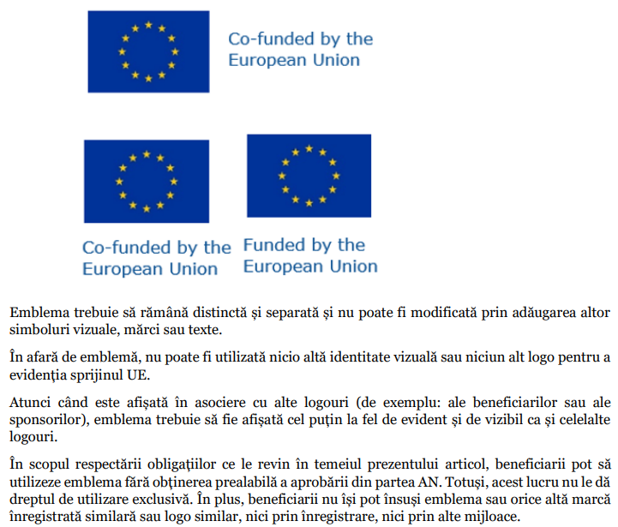
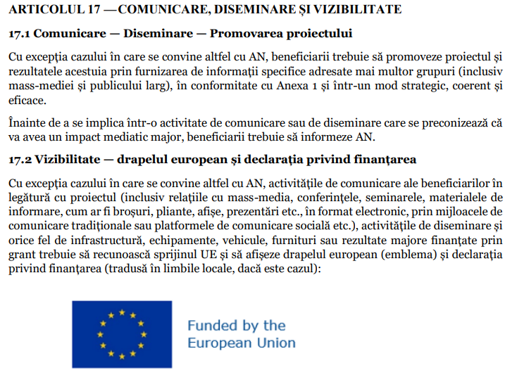
Erasmus+ Programme Key Action 2 Cooperation Partnerships
for Higher Education (KA220-HED)
Agreement number 2023-1-RO01-KA220-HED-000155412
European Network for Additive Manufacturing in Industrial Design for Ukrainian Context
Project Funding Contract

Slide 31
Erasmus+ Programme Key Action 2 Cooperation Partnerships
for Higher Education (KA220-HED)
Agreement number 2023-1-RO01-KA220-HED-000155412
European Network for Additive Manufacturing in Industrial Design for Ukrainian Context
Project Funding Contract

Slide 32
Erasmus+ Programme Key Action 2 Cooperation Partnerships
for Higher Education (KA220-HED)
Agreement number 2023-1-RO01-KA220-HED-000155412
European Network for Additive Manufacturing in Industrial Design for Ukrainian Context
Project Funding Contract
SECTION 17 — COMMUNICATION, DISSEMINATION AND VISIBILITY
17.1 Communication — Dissemination — Promotion of the project
Unless otherwise agreed with the NA, the beneficiaries must promote the project and its results by providing specific information addressed to several groups (incl media and the general public), in accordance with Annex 1 and in a strategic, coherent and effective.
Before engaging in a communication or dissemination activity that is expected to will have a major media impact, the beneficiaries must inform the AN.
17.2 Visibility — European flag and funding statement Unless otherwise agreed with the NA, the communication activities of the beneficiaries in connection with the project (including media relations, conferences, seminars, materials of information, such as brochures, leaflets, posters, presentations, etc., in electronic format, by means of traditional communication or social communication platforms, etc.), dissemination activities and any infrastructure, equipment, vehicles, supplies or major deliverables funded by grant must acknowledge EU support and display the European flag (emblem) and declaration on funding (translated into local languages, if applicable):

Slide 33
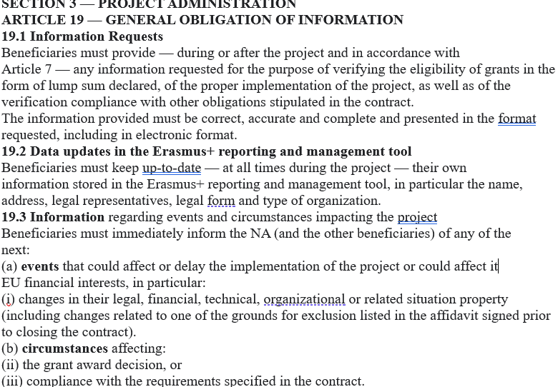
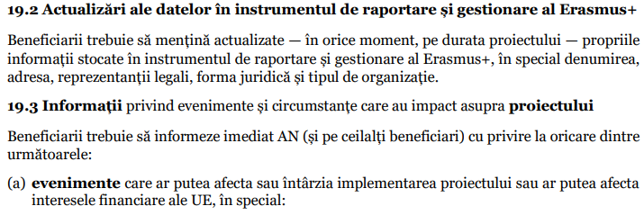
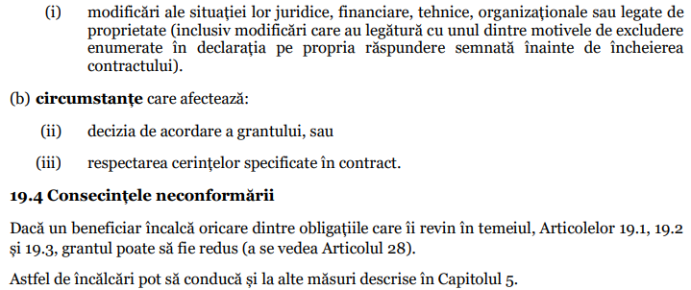
Erasmus+ Programme Key Action 2 Cooperation Partnerships
for Higher Education (KA220-HED)
Agreement number 2023-1-RO01-KA220-HED-000155412
European Network for Additive Manufacturing in Industrial Design for Ukrainian Context
Project Funding Contract

Slide 34
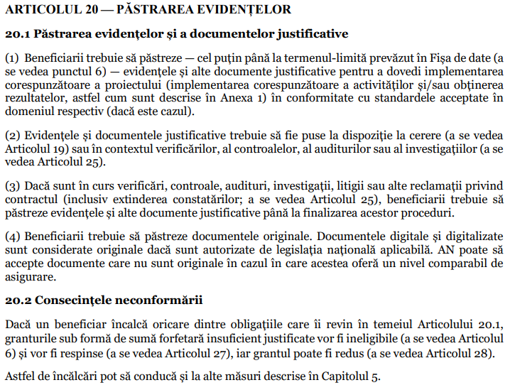
Erasmus+ Programme Key Action 2 Cooperation Partnerships
for Higher Education (KA220-HED)
Agreement number 2023-1-RO01-KA220-HED-000155412
European Network for Additive Manufacturing in Industrial Design for Ukrainian Context
Project Funding Contract
ARTICLE 20 — KEEPING OF RECORDS
20.1 Keeping records and supporting documents
(1) Beneficiaries must keep — at least until the deadline provided in the Data Sheet (a see point 6) — the records and other supporting documents to prove the implementation appropriateness of the project (proper implementation of activities and/or obtaining results, as described in Annex 1) in accordance with the standards accepted in that domain (if applicable).
(2) Records and supporting documents must be made available upon request (see Article 19) or in the context of checks, controls, audits or investigations (as see Article 25).
(3) If checks, controls, audits, investigations, litigations or other complaints regarding
contract (including extension of findings; see Article 25), beneficiaries must keep records and other supporting documents until these procedures are completed.
(4) Beneficiaries must keep the original documents. Digital and digitized documents
are considered original if authorized by applicable national law. AN can accept non-original documents if they offer a comparable level of insurance.
20.2 Consequences of Non-Compliance
If a beneficiary breaches any of its obligations under Article 20.1, grants in the form of an insufficiently justified lump sum will be ineligible (see Article 6) and will be rejected (see Article 27), and the grant may be reduced (see Article 28).

Slide 35
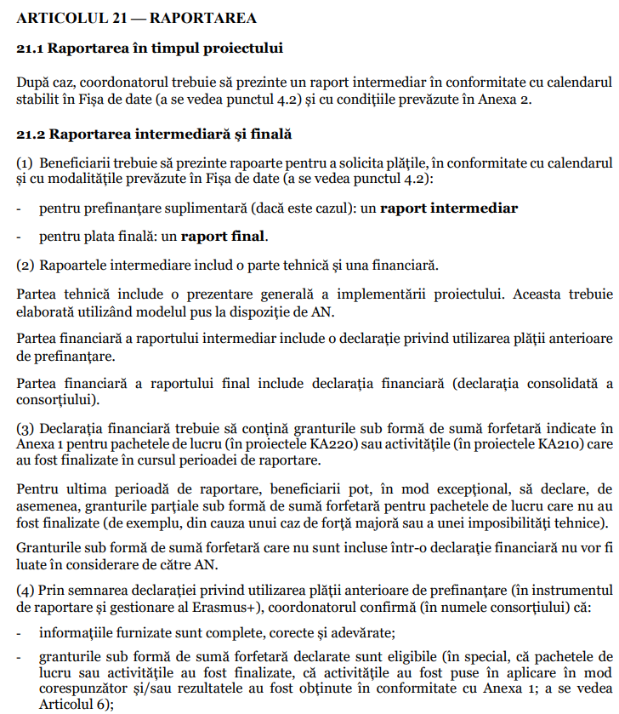
Erasmus+ Programme Key Action 2 Cooperation Partnerships
for Higher Education (KA220-HED)
Agreement number 2023-1-RO01-KA220-HED-000155412
European Network for Additive Manufacturing in Industrial Design for Ukrainian Context
ARTICLE 21 — REPORTING
21.1 Reporting During the Project
If necessary, the coordinator must submit an interim report in accordance with the timetable
established in the Data Sheet (see point 4.2) and with the conditions set out in Annex 2.
21.2 Interim and Final Reporting
(1) Beneficiaries must submit reports to request payments, in accordance with the calendar
and with the methods provided in the Data Sheet (see point 4.2):
- for additional pre-financing (if applicable): an interim report
- for final payment: a final report.
(2) The interim reports include a technical and a financial part.
The technical part includes an overview of the project implementation. This must developed using the model made available by AN.
The financial part of the interim report includes a statement on the use of the previous payment
of pre-financing.
The financial part of the final report includes the financial statement (consolidated statement a
consortium).
(3) The financial statement must contain the grants in the form of a lump sum indicated in
Annex 1 for work packages (in KA220 projects) or activities (in KA210 projects) that
were completed during the reporting period.
For the last reporting period, the beneficiaries can, exceptionally, declare, of also partial grants in the form of a lump sum for work packages that do not have been completed (for example, due to a case of force majeure or a technical impossibility).
Lump sum grants that are not included in a financial statement will not be taken into account by the AN.
(4) By signing the declaration regarding the use of the previous pre-financing payment (in the instrument reporting and management of Erasmus+), the coordinator confirms (on behalf of the consortium) that:
- the information provided is complete, correct and true;
- grants in the form of a declared lump sum are eligible (in particular, that packages of work or activities have been completed, that the activities have been implemented in the manner accordingly and/or the results were obtained in accordance with Annex 1; to be seen Article 6);
- the appropriate implementation and/or achievement can be justified by records and documents
appropriate justifications (see Article 20 and Annex 2), which will be presented upon request (see
see Article 19) or in the context of checks, controls, audits and investigations (a
see Article 25).
In case of recoveries (see Article 22), the beneficiaries will also be liable for the grants in the form of a lump sum declared for their affiliated entities (if applicable).
Project Funding Contract

Slide 36
Erasmus+ Programme Key Action 2 Cooperation Partnerships
for Higher Education (KA220-HED)
Agreement number 2023-1-RO01-KA220-HED-000155412
European Network for Additive Manufacturing in Industrial Design for Ukrainian Context
Project Funding Contract
21.3 The currency in which the financial statements are expressed and the conversion to euros
Financial statements must be drawn up in euros.
21.4 Reporting Language
Reporting must be done in the language in which the contract is drawn up, unless which is otherwise agreed with the AN (see Data sheet, point 4.2).

Slide 37
Erasmus+ Programme Key Action 2 Cooperation Partnerships
for Higher Education (KA220-HED)
Agreement number 2023-1-RO01-KA220-HED-000155412
European Network for Additive Manufacturing in Industrial Design for Ukrainian Context
Project Funding Contract
22.3.2 Amount due upon termination of the beneficiary's participation — Recovery
In the event of termination of the beneficiary's participation, the AN will determine the provisional amount due for the beneficiary in question. Any payments will be made together with the final payment.

Slide 38
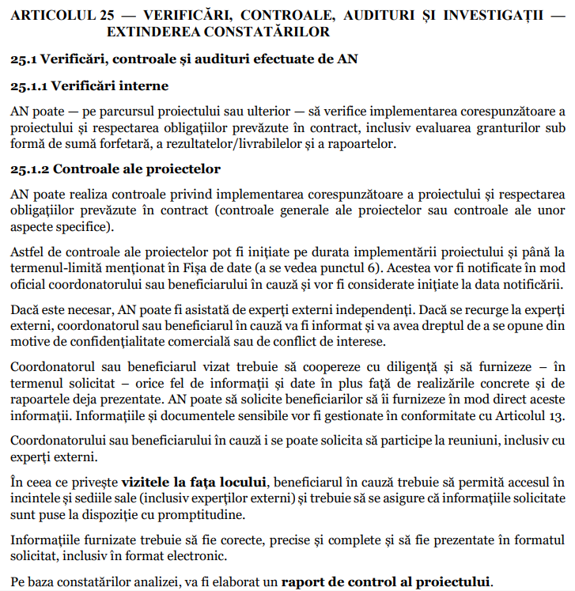
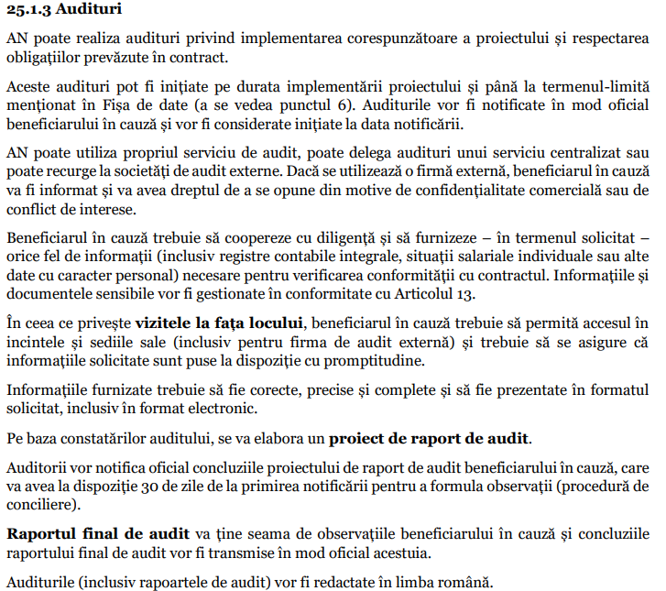
Erasmus+ Programme Key Action 2 Cooperation Partnerships
for Higher Education (KA220-HED)
Agreement number 2023-1-RO01-KA220-HED-000155412
European Network for Additive Manufacturing in Industrial Design for Ukrainian Context

Slide 39
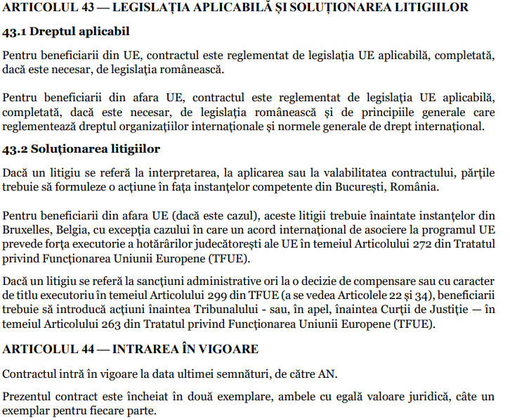
Erasmus+ Programme Key Action 2 Cooperation Partnerships
for Higher Education (KA220-HED)
Agreement number 2023-1-RO01-KA220-HED-000155412
European Network for Additive Manufacturing in Industrial Design for Ukrainian Context
Project Funding Contract

Slide 40
Erasmus+ Programme Key Action 2 Cooperation Partnerships
for Higher Education (KA220-HED)
Agreement number 2023-1-RO01-KA220-HED-000155412
European Network for Additive Manufacturing in Industrial Design for Ukrainian Context
Kick off Meeting – Transnational Project Meeting TPM1 – UNSTPB Bucharest, 27-29 nov 2023
Project Budget: 120 000 Euro, for a year between 15.11.2023 – 14.11.2024
First funding realized by Romanian Agency: 96 000 Euro (80% from project budget)
At the final of project, it will give the rest of 20% from project budget if all the objectives of the project have been met.
The money was transmitted by UNSTPB to all the AMAZE project partners, this being confirmed by the partners.

Slide 41
Erasmus+ Programme Key Action 2 Cooperation Partnerships
for Higher Education (KA220-HED)
Agreement number 2023-1-RO01-KA220-HED-000155412
European Network for Additive Manufacturing in Industrial Design for Ukrainian Context
Kick off Meeting – Transnational Project Meeting TPM1 – UNSTPB Bucharest, 27-29 nov 2023
Project workpackages:
IO1 - AMAZE e-book for developing of complex design industrial parts (15.11.2023 – 14.03.2024) – Leading organisation - UNSTPB
IO2 - AMAZE e-toolkit manual for digital learning in producing complex design industrial parts (15.03.2024 – 14.06.2024) – Leading organisation CHNU
IO3 - AMAZE e-learning VR/AR platform for virtual laboratory (15.06.2024 – 14.09.2024) - Leading organisation Edibon International S.A.
IO4 – AMAZE e-case studies for project-based learning method used in developing, testing and manufacturing of customized industrial parts by Additive Manufacturing technologies (some 3D models, cases of design or architectural models) (15.09.2024-14.11.2024) – Leading organisation PUT
Project Management and Dissemination Results (15.11.2023 – 14.11.2024)

Slide 42
Erasmus+ Programme Key Action 2 Cooperation Partnerships
for Higher Education (KA220-HED)
Agreement number 2023-1-RO01-KA220-HED-000155412
European Network for Additive Manufacturing in Industrial Design for Ukrainian Context
Kick off Meeting – Transnational Project Meeting TPM1 – UNSTPB Bucharest, 27-29 nov 2023
Distribution of the grant amount among participating organisations
UNSTPB CHNU PUT EDIBON

Slide 43
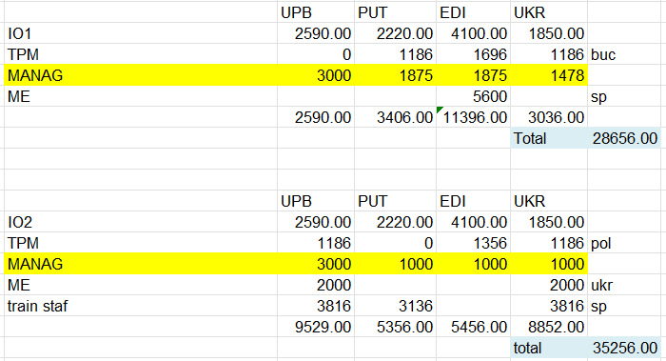
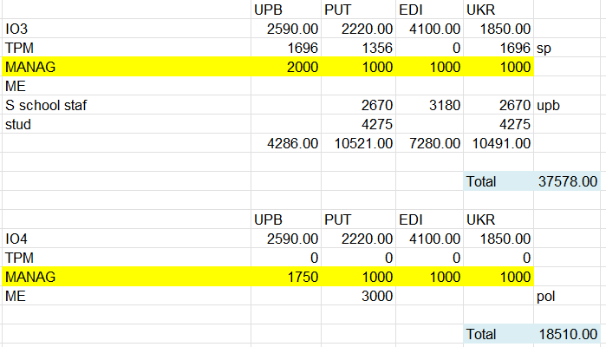
Erasmus+ Programme Key Action 2 Cooperation Partnerships
for Higher Education (KA220-HED)
Agreement number 2023-1-RO01-KA220-HED-000155412
European Network for Additive Manufacturing in Industrial Design for Ukrainian Context
Project Budget

Slide 44
Erasmus+ Programme Key Action 2 Cooperation Partnerships
for Higher Education (KA220-HED)
Agreement number 2023-1-RO01-KA220-HED-000155412
European Network for Additive Manufacturing in Industrial Design for Ukrainian Context
Kick off Meeting – Transnational Project Meeting TPM1 – UNSTPB Bucharest, 27-29 nov 2023
Project workpackages:
IO1 - AMAZE e-book for developing of complex design industrial parts (15.11.2023 – 14.03.2024) – Leading organisation – UNSTPB
comprising the next module courses:
1-Additive Manufacturing (UPB);
2-Smart (Intelligent) Materials (YFCNU+PUT);
3-CAD/CAM/CAE design (YFCNU);
4- Reverse Engineering (PUT);
5-Computer Programming (Edibon);
6-Sensors and Electronics (UPB);
7-Virtual Reality/Augmented Reality (Edibon)
Multiplier EVENT ME1 -1 day (40 persons from different companies and 8 foreigners) – EDIBON International S.A. – 23 January 2024

Slide 45
Erasmus+ Programme Key Action 2 Cooperation Partnerships
for Higher Education (KA220-HED)
Agreement number 2023-1-RO01-KA220-HED-000155412
European Network for Additive Manufacturing in Industrial Design for Ukrainian Context
Kick off Meeting – Transnational Project Meeting TPM1 – UNSTPB Bucharest, 27-29 nov 2023
Project workpackages:
IO2 - AMAZE e-toolkit manual for digital learning in producing complex design industrial parts (15.03.2024 – 14.06.2024) – Leading organisation CHNU
comprising the next toolkit modules:
1-Additive Manufacturing (UNSTPB);
2-Smart (Intelligent) Materials (YFCNU+PUT);
3-CAD/CAM/CAE design (YFCNU);
4- Reverse Engineering (PUT);
5-Computer Programming (Edibon);
6-Sensors and Electronics (UNSTPB);
7-Virtual Reality/Augmented Reality (Edibon)
Multiplier Events:
ME2 – 1 day hosted by UNSTPB (ROM) (20 persons out from UNSTPB) and 24 may 2023
ME3 – 1 day hosted by YFCNU (UKR) (20 persons from outside of university) – 8-12 apr. 2024
Training staff feedbacks EDIBON (SP) during 4 days, participating from each partner institution 4 persons (in total 16 persons) – 7 may – 12 may 2024
For TPM2 –hosted by PUT (POL) will participate 2 staff, professors, key persons by each institution involved in project (Total 8 pers) and others – 3 days (10 – 12 June 2024)

Slide 46
Erasmus+ Programme Key Action 2 Cooperation Partnerships
for Higher Education (KA220-HED)
Agreement number 2023-1-RO01-KA220-HED-000155412
European Network for Additive Manufacturing in Industrial Design for Ukrainian Context
Kick off Meeting – Transnational Project Meeting TPM1 – UNSTPB Bucharest, 27-29 nov 2023
Project workpackages:
IO3 - AMAZE e-learning VR/AR platform for virtual laboratory (15.06.2024 – 14.09.2024) - Leading organisation Edibon International S.A.
Summer School feedbacks given by students and staffs involved in AMAZE project – UNSTPB – 10 days (staffs and students) – 8-17 July 2024
TPM3 (3 days), hosted by Edibon company (8 persons – 2 persons/institution) – 4-6 sep 2024

Slide 47
Erasmus+ Programme Key Action 2 Cooperation Partnerships
for Higher Education (KA220-HED)
Agreement number 2023-1-RO01-KA220-HED-000155412
European Network for Additive Manufacturing in Industrial Design for Ukrainian Context
Kick off Meeting – Transnational Project Meeting TPM1 – UNSTPB Bucharest, 27-29 nov 2023
Project workpackages:
IO4 – AMAZE e-case studies for project-based learning method used in developing, testing and manufacturing of customized industrial parts by Additive Manufacturing technologies (some 3D models, cases of design or architectural models) (15.09.2024-14.11.2024) – Leading organisation PUT
Multiplier Event ME4 realized at PUT (POL), having invited 20 persons from different companies, universities, research centers (out of PUT) and 5 foreigner’s participants – 30 sep 2024

Slide 48
Erasmus+ Programme Key Action 2 Cooperation Partnerships
for Higher Education (KA220-HED)
Agreement number 2023-1-RO01-KA220-HED-000155412
European Network for Additive Manufacturing in Industrial Design for Ukrainian Context
Kick off Meeting – Transnational Project Meeting TPM1 – UNSTPB Bucharest, 27-29 nov 2023
EXPERIMENTAL RESEARCHES IN UPB
[1] BĂILĂ Diana, Cătălin Vițelaru, Roxana Trușcă, Lidia Ruxandra
Constantin, Ancuța Păcurar, Constantina Anca Parau and Răzvan
Păcurar, "Thin Films Deposition of Ta2O5 and ZnO by E-Gun
Technology on Co-Cr Alloy Manufactured by Direct Metal Laser
Sintering", Materials 2021, 14(13), 3666; (Q1/Q2, IF 2020 =
3,623)
WOS:000671401000001 (autor corespondent)
[2] Răzvan Păcurar, Petru Berce, Ovidiu Nemeş, Diana Băilă, Dan
Sergiu Stan, Alexandru Oarcea, Florin Popişter, Cristina Miron
Borzan, Sven Maricic, Stanislaw Legutko and Ancuţa Păcurar, "Cast
Iron Parts Obtained in Ceramic Molds Produced by Binder Jetting
3D Printing—Morphological and Mechanical Characterization",
Materials 2021, 14(16), 4502; (Q1/Q2, IF 2020 = 3,623)
WOS: 000690632100001 (autor corespondent)
[3] BĂILĂ Diana, Mocioiu Oana, Zaharia Cătălin, Trușcă Roxana,
Surdu Adrian, Bunea Mihaela, “Bioactivity of Co-Cr alloy samples
sintered by DMLS process and coated with hydroxyapatite obtained
by sol-gel method”, Rev. Roum. Chim., ISSN: 0035-3930,
(IF2015=0,250), vol.60(9), pp.921-930, 2015.
WOS:000366442600010 (autor corespondent)
[7] O.C. Mocioiu, I. Atkinson, J. Cusu-Pandele, V. Bratan, S. Petrescu, D.I. BĂILĂ, A.M. Mocioiu, „Structural and physico-chemical characterization of Zn-doped SiO2 glasses obtained by sol-gel route”, Revue Roumaine de Chimie, ISSN: 0035-3930, (IF2018=0.395), Vol.63, Iss. 5-6, pp. 419-424, 2018.
WOS: 000452555100006
[8] BĂILĂ Diana, Tonoiu Sergiu, “Hydrides precipitation in Ti6Al4V titanium alloy used for airframe manufacturing”, Bulletin of the Polish Academy of Sciences -Technical Sciences, ISSN/eISSN: 0239-7528/ 2300-1917, (IF2019=1.385), vol.67, no.3, pp. 643-649, 2019.
WOS:000473332000021 (autor corespondent)
[9] BĂILĂ Diana, Zaharia Cătălin, Mocioiu Oana, „Contact angle measurements at the interface of Co-Cr alloy sintered by DMLS and coated with hydroxyapatite”, Vjesnik Tehnical Gazette Croatia, ISSN/ eISSN: 1330-3651/ 1848-6339, (IF2020=0.783), vol. 27, no.2, pp. 583-588, 2020.
WOS:000527241900032 (autor corespondent)
[4] BĂILĂ Diana, Mocioiu Oana, Zaharia Cătălin, Trușcă Roxana,
Surdu Adrian, Bunea Mihaela, “In vitro behavior of sintered
compacts of Co-Cr doped with hydroxyapatite for biomedical
implants”, Journal of Optoelectronics and Advanced Materials,
ISSN/eISSN: 1454-4164/ 1841-7132, (IF2015=0,383), vol.17, No.7-
8, pp.1210-1218, 2015.
WOS:000359967600047 (autor corespondent)
[5] BĂILĂ Diana, Mocioiu Oana, Trușcă Roxana, Surdu Adrian, Zaharia
Cătălin, Bunea Mihaela, “Biodegradation and mechanical behaviour
of sintered compacts of Co-Cr alloy powder doped with ZrO2 used
in dentistry”, Vjesnik Tehnical Gazette Croatia. ISSN/eISSN: 1330-
3651/ 1848-6339, (IF2016=0.723), vol.23, no.4, pp.1047-1057,
2016.
WOS:000382353400016 (autor corespondent)
[6] BĂILĂ Diana, Doicin Cristian, Cotruț Cosmin, Ulmeanu Mihaela,
Ghionea Ionuț, Tarbă Cristian, “Sintering the beaks of the elevator
manufactured by Direct Metal Laser Sintering (DMLS) process
from Co-Cr alloy”, Journal Metalurgija Croatia, ISSN: 0543-5846,
vol. 55(4), pp.663-666, 2016.
WOS:000376167100022 (autor corespondent)

Slide 49
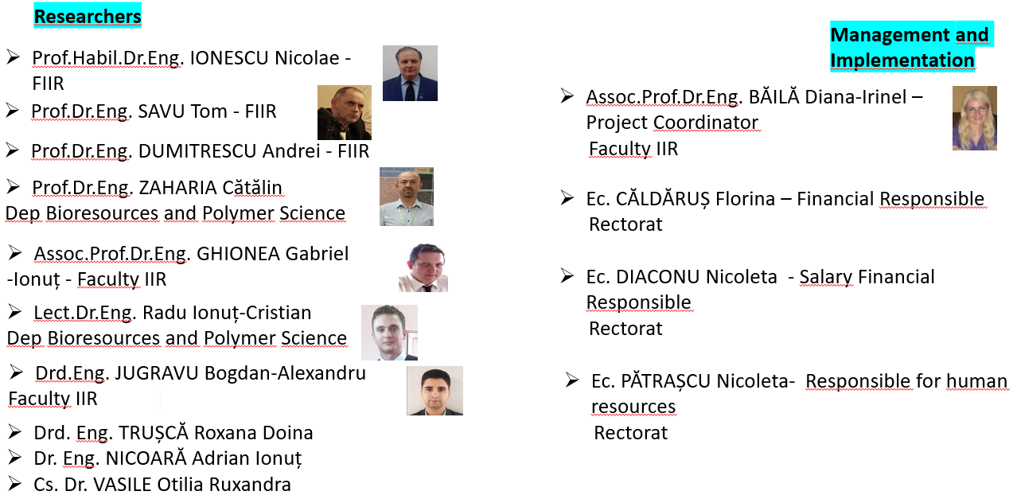
Erasmus+ Programme Key Action 2 Cooperation Partnerships
for Higher Education (KA220-HED)
Agreement number 2023-1-RO01-KA220-HED-000155412
European Network for Additive Manufacturing in Industrial Design for Ukrainian Context
HUMAN RESOURCES - UNSTPB

Slide 50
Erasmus+ Programme Key Action 2 Cooperation Partnerships
for Higher Education (KA220-HED)
Agreement number 2023-1-RO01-KA220-HED-000155412
European Network for Additive Manufacturing in Industrial Design for Ukrainian Context
Dissemination Results
SLS – material PA12
FDM – PEEK, PLA, PLA Silk Rainbow, PLA Silk Like Kingfisher Rainbow Colours (Silicone properties)
DLP, SLA – biocompatible photopolymer resins
DMLS/SLM – Ti6Al4V, superalloy Co-Cr – biocompatible materials
Analysis Test recommended for the materials used for the components:
SEM (Scanning Electron Microscopy)
TEM (Transmission Electron Microscopy)
EDAX (Energy Dispersive X-ray Analysis)
XRD (X-Ray Diffraction)
FTIR (Fourier Transform Infrared Spectroscopy)
RAMAN (Raman Spectroscopy)
AFM (Atomic Force Microscopy)
Contact angle test
Mechanical tests

Slide 52
Erasmus+ Programme Key Action 2 Cooperation Partnerships
for Higher Education (KA220-HED)
Agreement number 2023-1-RO01-KA220-HED-000155412
European Network for Additive Manufacturing in Industrial Design for Ukrainian Context
AMAZE PROJECT - RESEARCH DIRECTIONS
This project will lead to the opening of new topics and research directions that will be capitalized in projects such as:
HORIZON 2020
CORDIS EU
EEA GRANTS
EUROSTARS (EUREKA)
TEMPUSV
ERASMUS-MUNDUS ACTION3, etc.

Slide 53
Thank you!
Thank you!

