Slide 1


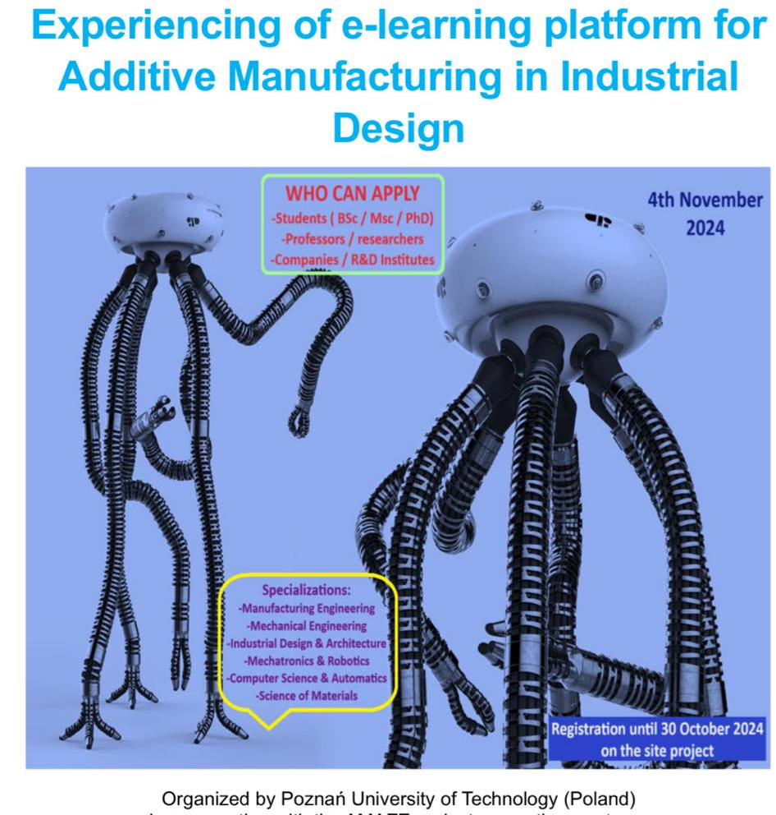




Erasmus+ Programme Key Action 2 Cooperation Partnerships
for Higher Education (KA220-HED)
Agreement number 2023-1-RO01-KA220-HED-000155412
European Network for Additive Manufacturing in Industrial Design for Ukrainian Context,
Poznan, POLAND, November 4th, 2024
MULTIPLIER EVENT 4
Poznan University of Technology, November 4th, 2024
Reverse Engineering
Remigiusz ŁABUDZKI, remigiusz.labudzki@put.poznan.pl Poznan University of Technology | Natalia WIERZBICKA, natalia.wierzbicka@put.poznan.pl Poznan University of Technology

Slide 2
Erasmus+ Programme Key Action 2 Cooperation Partnerships
for Higher Education (KA220-HED)
Agreement number 2023-1-RO01-KA220-HED-000155412
European Network for Additive Manufacturing in Industrial Design for Ukrainian Context,
Poznan, POLAND, November 4th, 2024
MULTIPLIER EVENT 4
Poznan University of Technology, November 4th, 2024
AGENDA
1. Introduction
2. Reverse Engineering techniques
3. Application of reverse engineering to the production of biomedical engineering products

Slide 3
Erasmus+ Programme Key Action 2 Cooperation Partnerships
for Higher Education (KA220-HED)
Agreement number 2023-1-RO01-KA220-HED-000155412
European Network for Additive Manufacturing in Industrial Design for Ukrainian Context,
Poznan, POLAND, November 4th, 2024
1. Introduction
Reverse engineering in the context of product manufacturing involves analyzing an existing product to understand its design, functionality, and components. This process can provide valuable insights for various applications in product development and manufacturing. In the toolkit a detailed description of how reverse engineering applies to product manufacturing was presented,
a) Product Analysis and Improvement
b) Cost Reduction
c) Intellectual Property and Innovation
d) Legacy Products and Support
e) Quality Control and Testing
f) Sustainability and Recycling
g) Rapid Prototyping

Slide 4
Erasmus+ Programme Key Action 2 Cooperation Partnerships
for Higher Education (KA220-HED)
Agreement number 2023-1-RO01-KA220-HED-000155412
European Network for Additive Manufacturing in Industrial Design for Ukrainian Context,
Poznan, POLAND, November 4th, 2024
Reverse engineering in product manufacturing involves analyzing a product to understand its design, architecture, and functionality. It allows manufacturers to recreate and improve existing products, ensure compatibility, or develop new products based on existing ones. Here are several common techniques used in reverse engineering, which was also detailed descipted in toolkit:
Physical Disassembly,
3D Scanning,
Computer-Aided Design (CAD) Reconstruction,
Material Analysis,
Functional Analysis,
Electrical Analysis,
Software Analysis,
Prototyping,
Metrology.

Slide 5
Erasmus+ Programme Key Action 2 Cooperation Partnerships
for Higher Education (KA220-HED)
Agreement number 2023-1-RO01-KA220-HED-000155412
European Network for Additive Manufacturing in Industrial Design for Ukrainian Context,
Poznan, POLAND, November 4th, 2024
Each technique can be utilized individually or in combination, depending on the complexity of the product and the objectives of the reverse engineering process. Reverse engineering plays a crucial role in product development, competitive analysis, and innovation within manufacturing industries.
The whole process of RE should be computer aided

Slide 6
Erasmus+ Programme Key Action 2 Cooperation Partnerships
for Higher Education (KA220-HED)
Agreement number 2023-1-RO01-KA220-HED-000155412
European Network for Additive Manufacturing in Industrial Design for Ukrainian Context,
Poznan, POLAND, November 4th, 2024
2. Reverse Engineering techniques
2.1 CMM Scanning
CMM scanning is a critical technique used in reverse engineering to create digital representations of physical objects. This process typically involves using advanced imaging technology to capture the geometry, shape, and sometimes even the colour or texture of an object.
Generic RE process using 3D scanning technology

Slide 7
Erasmus+ Programme Key Action 2 Cooperation Partnerships
for Higher Education (KA220-HED)
Agreement number 2023-1-RO01-KA220-HED-000155412
European Network for Additive Manufacturing in Industrial Design for Ukrainian Context,
Poznan, POLAND, November 4th, 2024
2. Reverse Engineering techniques
2.2 Optical Scanning
The purpose of reverse engineering is to manufacture another object based on a physic and existing object for which 3D CAD is not available.
The scanner can convert the physical object into point cloud. This kind of reverse engineering can be used to make digital 3D record of the objects, for security copies, shows it in presentations to the competitors about how it works, identify potential patent infringement.

Slide 8
Erasmus+ Programme Key Action 2 Cooperation Partnerships
for Higher Education (KA220-HED)
Agreement number 2023-1-RO01-KA220-HED-000155412
European Network for Additive Manufacturing in Industrial Design for Ukrainian Context,
Poznan, POLAND, November 4th, 2024
3. Application of reverse engineering to the production of biomedical engineering products
Reverse engineering is pivotal in medical life sciences, providing significant advantages such as reduced time and costs, along with enhanced product accuracy. Modern medical production systems integrate advanced measurement techniques to precisely capture human anatomy, sophisticated software for CAD model design, cutting-edge fabrication technologies, and innovative materials for improved manufacturing outcomes. In fields like orthopedics, dentistry, and reconstructive surgery, reverse engineering enables detailed imaging, modeling, and replication of
a patient’s bone structure, allowing surgeons to meticulously plan and evaluate procedures before actual implementation.

Slide 9
Erasmus+ Programme Key Action 2 Cooperation Partnerships
for Higher Education (KA220-HED)
Agreement number 2023-1-RO01-KA220-HED-000155412
European Network for Additive Manufacturing in Industrial Design for Ukrainian Context,
Poznan, POLAND, November 4th, 2024
3.1 Reverse engineering in prosthetic application
Filip Górski and colleagues, in their article "Development and Testing of an Individualized Sensorized 3D Printed Upper Limb Bicycle Prosthesis for Adult Patients" present the design and evaluation of a personalized prosthetic device tailored for an adult patient, specifically for activities such as bicycle riding. The prosthesis was developed using 3D scanning, semi-automated design with the AutoMedPrint system, and low-cost Fused Deposition Modelling (FDM) technology for 3D printing. It features integrated force and movement sensors and was subjected to rigorous testing across various dynamic scenarios to assess functionality, mitigate potential risks, and refine the design prior to activating the end effector. The article comprehensively details the design, production, and testing processes, showcasing the successful implementation and identifying areas for mechanical and electrical improvements.

Slide 10
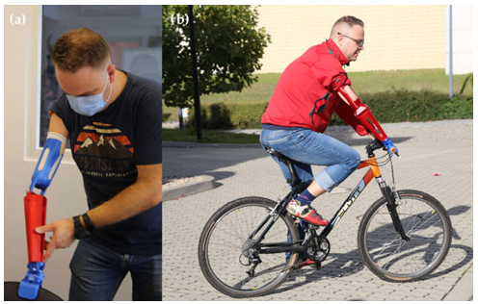
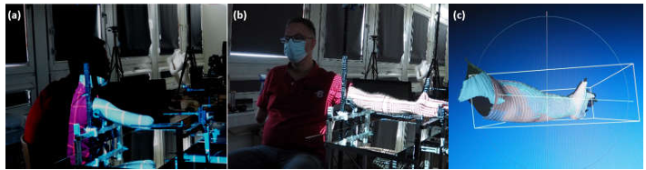
Erasmus+ Programme Key Action 2 Cooperation Partnerships
for Higher Education (KA220-HED)
Agreement number 2023-1-RO01-KA220-HED-000155412
European Network for Additive Manufacturing in Industrial Design for Ukrainian Context,
Poznan, POLAND, November 4th, 2024
3.1 Reverse engineering in prosthetic application
3D scanning of patient, (a) stump; (b) healthy arm; and (c) mesh data during processing
Tests of initial, mechanical version of the prosthesis,
(a) laboratory tests and (b) usability tests

Slide 11
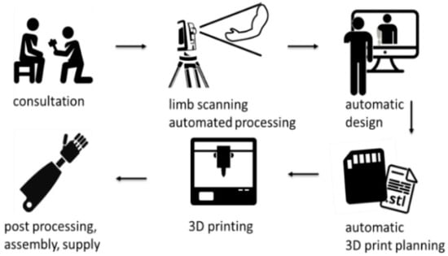
Erasmus+ Programme Key Action 2 Cooperation Partnerships
for Higher Education (KA220-HED)
Agreement number 2023-1-RO01-KA220-HED-000155412
European Network for Additive Manufacturing in Industrial Design for Ukrainian Context,
Poznan, POLAND, November 4th, 2024
3.2 Reverse engineering in hand therapy
The paper "Development and Studies of VR-Assisted Hand Therapy Using a Customized Biomechatronic 3D-Printed Orthosis" authored by Filip Górski and colleagues, explores the creation, testing, and use of a wrist–hand orthosis for hand therapy in a teenage patient with congenital paresis. The team enhanced a standard 3D-printed orthosis with sensors, transforming it into a motion controller for virtual reality (VR). Due to the patient’s wrist and hand impairments, standard VR controllers were not an option, so the orthosis was adapted by integrating custom electronics and motion trackers. A VR game, developed in collaboration with physiotherapists, replaced traditional VR inputs with those from the customized orthosis. This game was then tested on patients and evaluated by an expert to determine its effectiveness and identify areas for further improvement in the orthosis design.
Workflow of the AutoMedPrint system

Slide 12
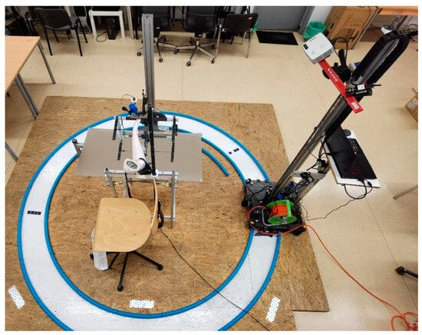
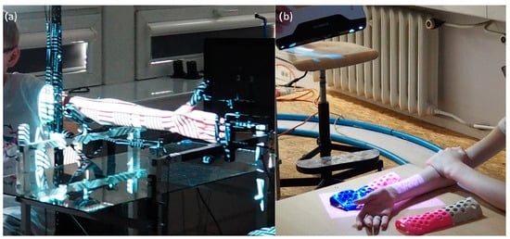
Erasmus+ Programme Key Action 2 Cooperation Partnerships
for Higher Education (KA220-HED)
Agreement number 2023-1-RO01-KA220-HED-000155412
European Network for Additive Manufacturing in Industrial Design for Ukrainian Context,
Poznan, POLAND, November 4th, 2024
3.2 Reverse engineering in hand therapy
Scanning of the patient, (a) left arm—mechanized rig, (b) right arm—manual scan
Prototype of AutoMedPrint system (scanning rig)

Slide 13
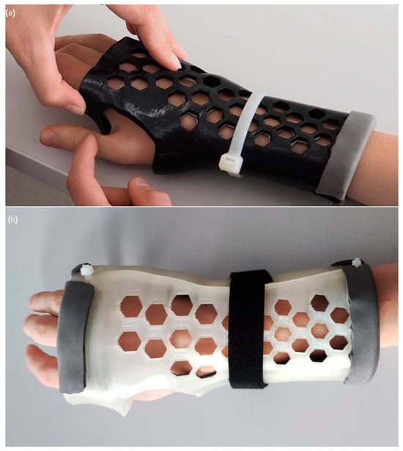
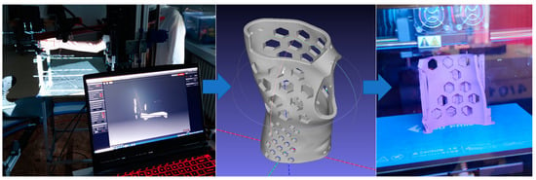
Erasmus+ Programme Key Action 2 Cooperation Partnerships
for Higher Education (KA220-HED)
Agreement number 2023-1-RO01-KA220-HED-000155412
European Network for Additive Manufacturing in Industrial Design for Ukrainian Context,
Poznan, POLAND, November 4th, 2024
3.2 Reverse engineering in hand therapy
Customized therapeutic orthosis design and production for the purpose of VR system prototyping
Customized therapeutic orthosis, (a) first version, and (b) second version (10 months later)

Slide 14
Erasmus+ Programme Key Action 2 Cooperation Partnerships
for Higher Education (KA220-HED)
Agreement number 2023-1-RO01-KA220-HED-000155412
European Network for Additive Manufacturing in Industrial Design for Ukrainian Context,
Poznan, POLAND, November 4th, 2024
  THANK YOU FOR YOUR ATTENTION ☺

