Slide 1
Erasmus+ Programme Key Action 2 Cooperation Partnerships
for Higher Education (KA220-HED)
Agreement number 2023-1-RO01-KA220-HED-000155412
European Network for Additive Manufacturing in Industrial Design for Ukrainian Context
Poznan, POLAND, November 4th, 2024
Staff Training – Edibon International S.A., Madrid, Spain, 04-06 September 2024
Reverse Engineering and Smart Materials
Adam PATALAS, adam.patalas@put.poznan.pl Poznan University of Technology | Paweł Zawadzki, pawel.zawadzki@put.poznan.pl Poznan University of Technology

Slide 2
Erasmus+ Programme Key Action 2 Cooperation Partnerships
for Higher Education (KA220-HED)
Agreement number 2023-1-RO01-KA220-HED-000155412
European Network for Additive Manufacturing in Industrial Design for Ukrainian Context
Poznan, POLAND, November 4th, 2024
Staff Training – Multipier Event, 04 November 2024
AGENDA
PUT AMAZE Team
Introduction to Smart Materials
3. Smart (Intelligent) Materials – e-Toolkit

Slide 3
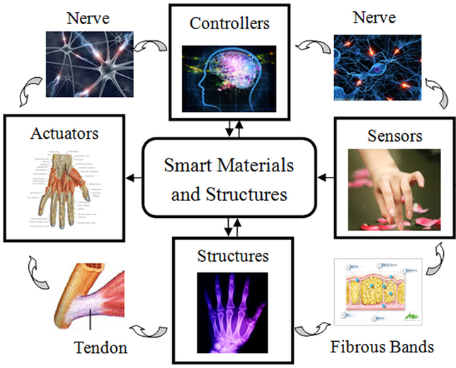
Erasmus+ Programme Key Action 2 Cooperation Partnerships
for Higher Education (KA220-HED)
Agreement number 2023-1-RO01-KA220-HED-000155412
European Network for Additive Manufacturing in Industrial Design for Ukrainian Context
Poznan, POLAND, November 4th, 2024
IO4 - EMERALD e-toolkit for industrial design for complex parts
SMART (INTELIGENT) MATERIALS

Slide 4
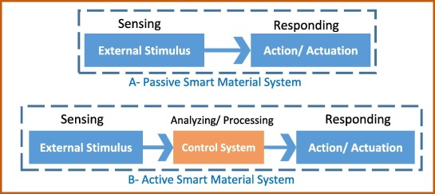
Erasmus+ Programme Key Action 2 Cooperation Partnerships
for Higher Education (KA220-HED)
Agreement number 2023-1-RO01-KA220-HED-000155412
European Network for Additive Manufacturing in Industrial Design for Ukrainian Context
Poznan, POLAND, November 4th, 2024
2. Introduction to Smart Materials
Smart materials, also called intelligent or responsive materials, are designed materials that have one or more properties that can be significantly changed in a controlled fashion by external stimuli, such as stress, moisture, electric or magnetic fields, light, temperature, pH, or chemical compounds. Smart materials are the basis of many applications, including sensors and actuators, or artificial muscles, particularly as electroactive polymers (EAPs).
we can divide them according to the effect of stimulation
Piezoelectric materials
Shape-memory alloys and shape-memory polymers
Photovoltaic materials or optoelectronics.
Electroactive polymers
Magnetostrictive materials
Magnetic shape memory

Slide 5
Erasmus+ Programme Key Action 2 Cooperation Partnerships
for Higher Education (KA220-HED)
Agreement number 2023-1-RO01-KA220-HED-000155412
European Network for Additive Manufacturing in Industrial Design for Ukrainian Context
Poznan, POLAND, November 4th, 2024
Shape Memory Alloys (SMAs)
(a) Comparision of SMA element attached at both ends of the actuator and located outside versus inside, (b) starfish-like soft robot with flexible rays actuated by SMA spring located within the structure, and (c) spring-driven robot with a silicone polimer body (Huai-Ti and Trimmer)
Rodrigue et al., 2022
Notes:
Shape-memory alloys and shape-memory polymers are materials in which large deformation can be induced and recovered through temperature changes or stress changes (pseudoelasticity). The shape memory effect results due to respectively martensitic phase change and induced elasticity at higher temperatures.

Slide 6
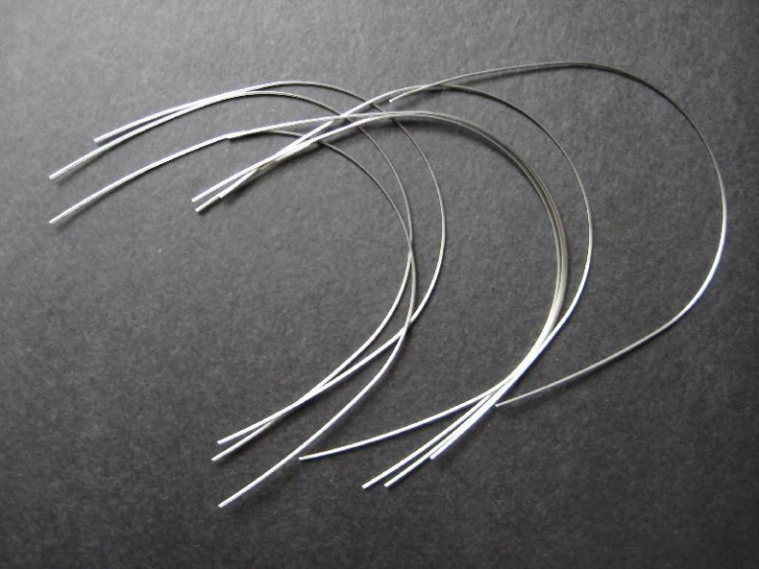
Erasmus+ Programme Key Action 2 Cooperation Partnerships
for Higher Education (KA220-HED)
Agreement number 2023-1-RO01-KA220-HED-000155412
European Network for Additive Manufacturing in Industrial Design for Ukrainian Context
Poznan, POLAND, November 4th, 2024
3.1 Experiment with SMAs
In prepared E-Toolkit, an experiment was described to create a spring using Nitinol—a material known for its shape memory properties. Nitinol is an alloy of nickel and titanium that can "remember" a specific shape and return to it when heated. Through this process, a programming procedure can be carried out that allows to creation of a spring that returns to its original form after being deformed. This experiment not only demonstrates the unique characteristics of Nitinol but also helps to understand how phase transformations can influence the material's mechanical properties.
Fig. Fragments of Nitinol wire prepared to experiment

Slide 7
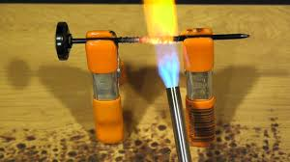
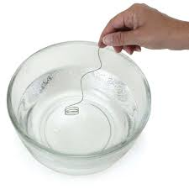
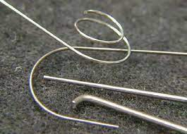
Erasmus+ Programme Key Action 2 Cooperation Partnerships
for Higher Education (KA220-HED)
Agreement number 2023-1-RO01-KA220-HED-000155412
European Network for Additive Manufacturing in Industrial Design for Ukrainian Context
Poznan, POLAND, November 4th, 2024
3.2 Process of preparing SMAs
Forming
Heating
Fast cooling
Notes:
Heating: Place the wound wire on the form in the gas torch or oven heated to around 500-550°C. Heating should last from a few minutes to about 10 minutes to ensure the entire wire reaches the required temperature. The wire should glow red but not melt. If using an oven, place the wire on a metal tray and try not to exceed the maximum temperature recommended for your oven.
Cooling: After heating, quickly transfer the wire (still on the form) to the container with cold water. Rapid cooling will quench the wire, setting its shape.

Slide 8
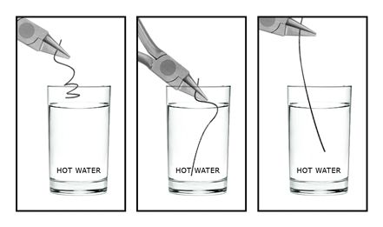
Erasmus+ Programme Key Action 2 Cooperation Partnerships
for Higher Education (KA220-HED)
Agreement number 2023-1-RO01-KA220-HED-000155412
European Network for Additive Manufacturing in Industrial Design for Ukrainian Context
Poznan, POLAND, November 4th, 2024
3.3 Testing properties of SMAs
Testing a shape memory of a Nitinol wire

Slide 9
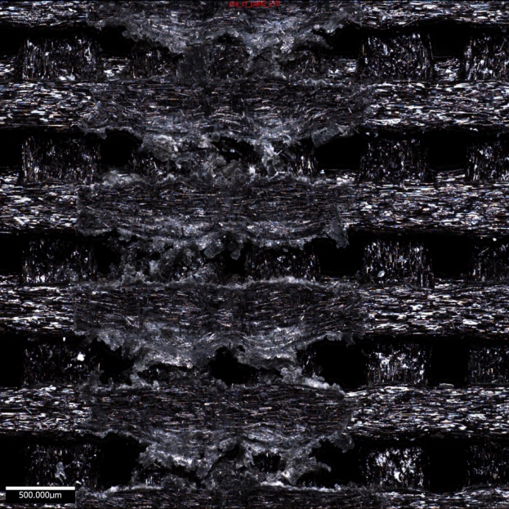
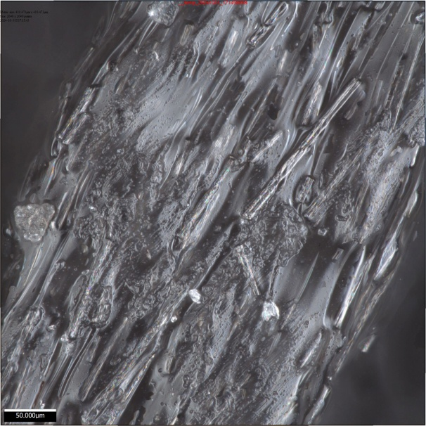
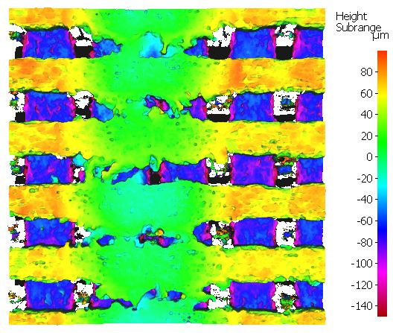
Erasmus+ Programme Key Action 2 Cooperation Partnerships
for Higher Education (KA220-HED)
Agreement number 2023-1-RO01-KA220-HED-000155412
European Network for Additive Manufacturing in Industrial Design for Ukrainian Context
Poznan, POLAND, November 4th, 2024
3.4 Article in preparation
Study of the Influence of FDM Printing Parameters on the Tribological Properties of the Surface Layer of Carbon Fiber Reinforced PLA
Examples of results achieved in the study

Slide 10
Erasmus+ Programme Key Action 2 Cooperation Partnerships
for Higher Education (KA220-HED)
Agreement number 2023-1-RO01-KA220-HED-000155412
European Network for Additive Manufacturing in Industrial Design for Ukrainian Context
Poznan, POLAND, November 4th, 2024

Slide 11
Erasmus+ Programme Key Action 2 Cooperation Partnerships
for Higher Education (KA220-HED)
Agreement number 2023-1-RO01-KA220-HED-000155412
European Network for Additive Manufacturing in Industrial Design for Ukrainian Context
Poznan, POLAND, November 4th, 2024
THANK YOU FOR YOUR ATTENTION ☺

