Slide 1








Erasmus+ Programme Key Action 2 Cooperation Partnerships
for Higher Education (KA220-HED)
Agreement number 2023-1-RO01-KA220-HED-000155412
European Network for Additive Manufacturing in Industrial Design for Ukrainian Context

Slide 2


Erasmus+ Programme Key Action 2 Cooperation Partnerships
for Higher Education (KA220-HED)
Agreement number 2023-1-RO01-KA220-HED-000155412
European Network for Additive Manufacturing in Industrial Design for Ukrainian Context
INDEX
1. ABOUT EDIBON
  VIDEO
  GENERAL INFORMATION
  SALES DEPARTMENT
2. EDIBON PRODUCTS
  COMPUTER CONTROLLED UNITS
  BASE / MANUAL UNITS
  ECL – EDIBON CLOUD LEARNING
  PILOT PLANTS
3. SCADA TEACHING TECHNOLOGY
  BASIC FUNDAMENTALS
  SOFTWARE EXPANSIONS
  VIDEO
4. POTENTIAL CUSTOMERS
  GENERAL INFORMATION
5. OUR WEBSITE
  GENERAL INFORMATION

Slide 3



Erasmus+ Programme Key Action 2 Cooperation Partnerships
for Higher Education (KA220-HED)
Agreement number 2023-1-RO01-KA220-HED-000155412
European Network for Additive Manufacturing in Industrial Design for Ukrainian Context

Slide 4

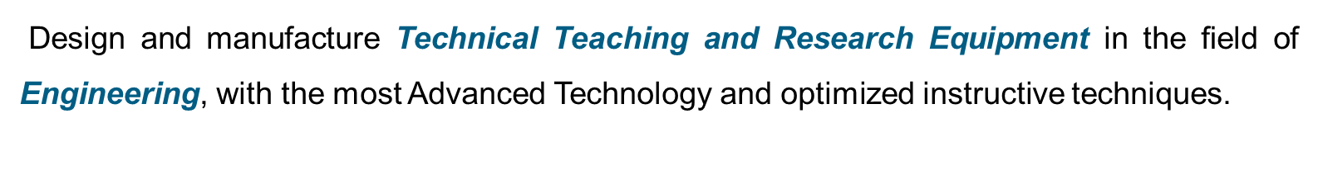










Erasmus+ Programme Key Action 2 Cooperation Partnerships
for Higher Education (KA220-HED)
Agreement number 2023-1-RO01-KA220-HED-000155412
European Network for Additive Manufacturing in Industrial Design for Ukrainian Context

Slide 5


Erasmus+ Programme Key Action 2 Cooperation Partnerships
for Higher Education (KA220-HED)
Agreement number 2023-1-RO01-KA220-HED-000155412
European Network for Additive Manufacturing in Industrial Design for Ukrainian Context

Slide 6




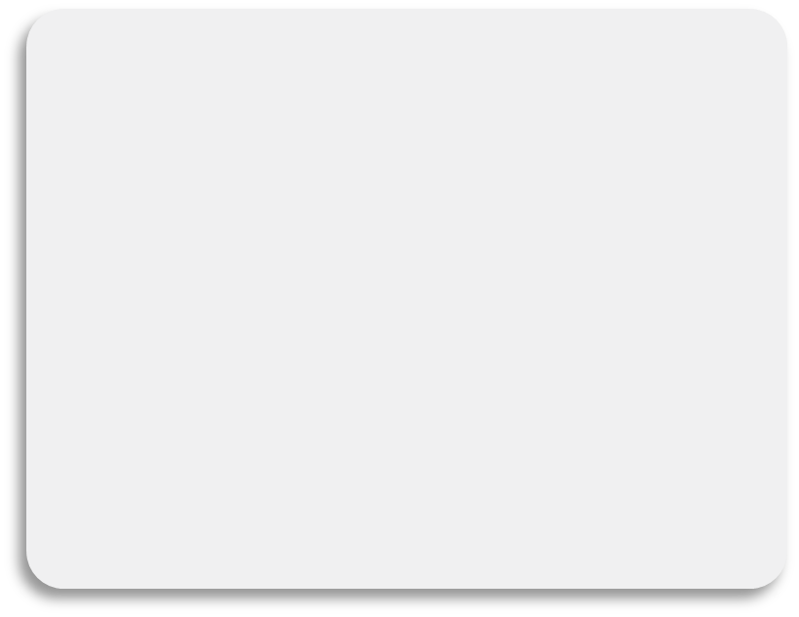

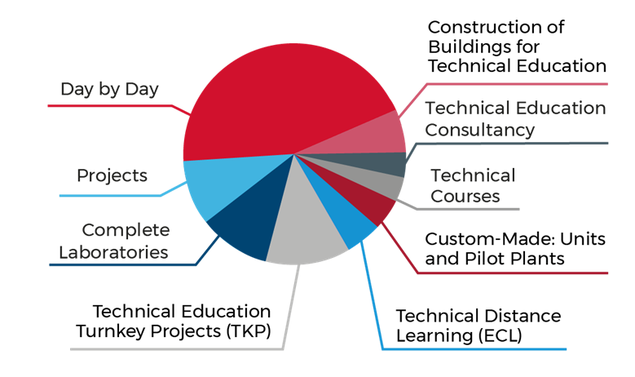

Erasmus+ Programme Key Action 2 Cooperation Partnerships
for Higher Education (KA220-HED)
Agreement number 2023-1-RO01-KA220-HED-000155412
European Network for Additive Manufacturing in Industrial Design for Ukrainian Context

Slide 7
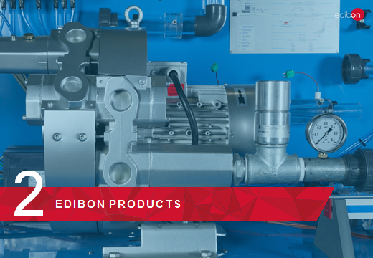
Erasmus+ Programme Key Action 2 Cooperation Partnerships
for Higher Education (KA220-HED)
Agreement number 2023-1-RO01-KA220-HED-000155412
European Network for Additive Manufacturing in Industrial Design for Ukrainian Context

Slide 8









ABOUT EDIBON: EDIBON Lines of Business.
Principal
Secondary
Notes:
JC/HJ

Slide 9
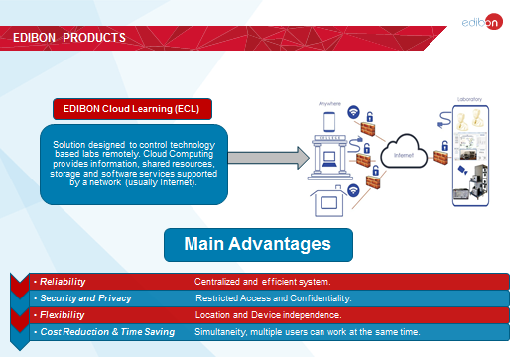
Erasmus+ Programme Key Action 2 Cooperation Partnerships
for Higher Education (KA220-HED)
Agreement number 2023-1-RO01-KA220-HED-000155412
European Network for Additive Manufacturing in Industrial Design for Ukrainian Context

Slide 10
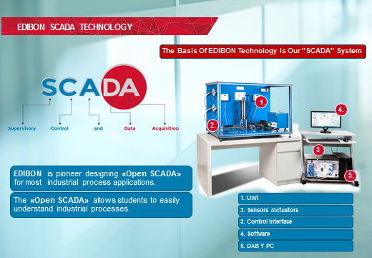
Erasmus+ Programme Key Action 2 Cooperation Partnerships
for Higher Education (KA220-HED)
Agreement number 2023-1-RO01-KA220-HED-000155412
European Network for Additive Manufacturing in Industrial Design for Ukrainian Context

Slide 11

Erasmus+ Programme Key Action 2 Cooperation Partnerships
for Higher Education (KA220-HED)
Agreement number 2023-1-RO01-KA220-HED-000155412
European Network for Additive Manufacturing in Industrial Design for Ukrainian Context

Slide 12
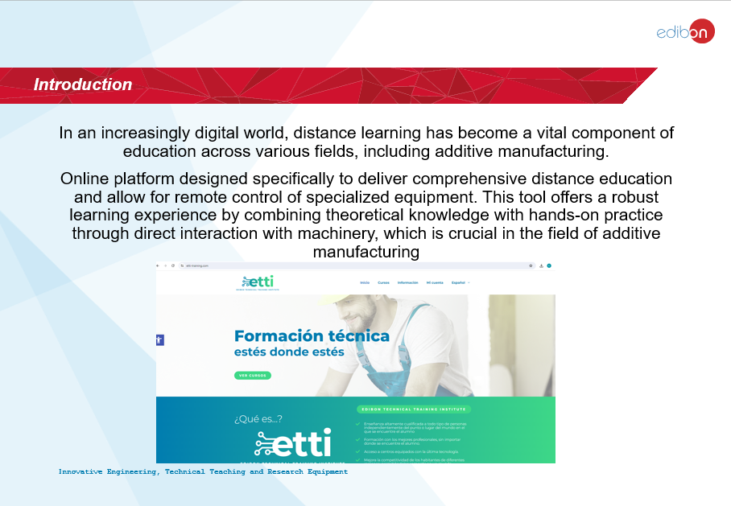
Erasmus+ Programme Key Action 2 Cooperation Partnerships
for Higher Education (KA220-HED)
Agreement number 2023-1-RO01-KA220-HED-000155412
European Network for Additive Manufacturing in Industrial Design for Ukrainian Context

Slide 13
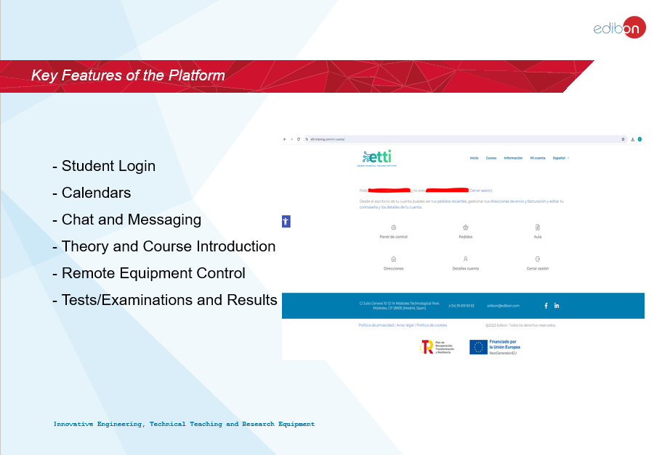
Erasmus+ Programme Key Action 2 Cooperation Partnerships
for Higher Education (KA220-HED)
Agreement number 2023-1-RO01-KA220-HED-000155412
European Network for Additive Manufacturing in Industrial Design for Ukrainian Context

Slide 14
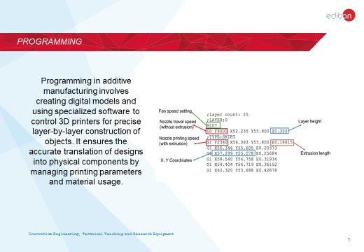
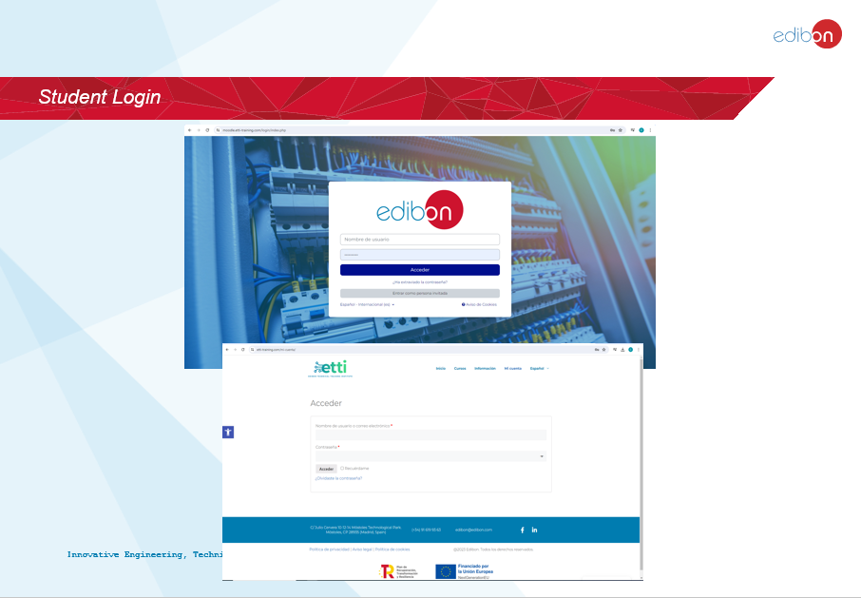
Erasmus+ Programme Key Action 2 Cooperation Partnerships
for Higher Education (KA220-HED)
Agreement number 2023-1-RO01-KA220-HED-000155412
European Network for Additive Manufacturing in Industrial Design for Ukrainian Context

Slide 15
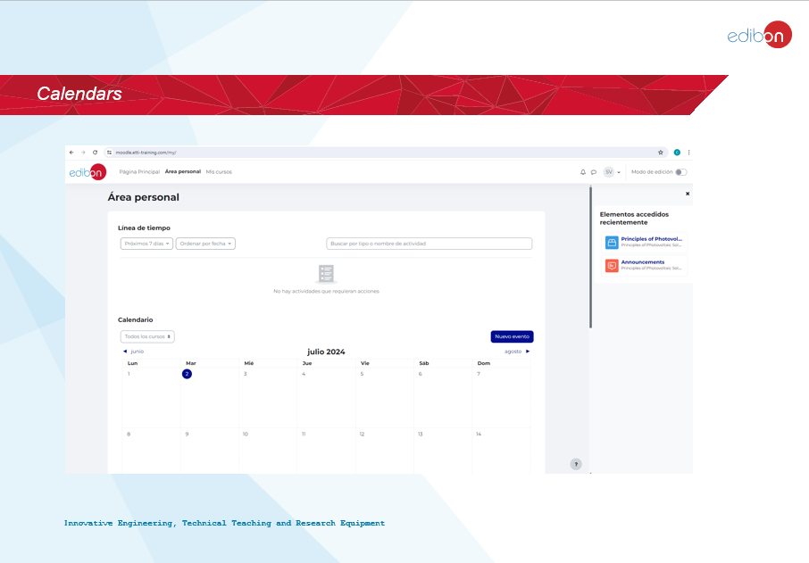
Erasmus+ Programme Key Action 2 Cooperation Partnerships
for Higher Education (KA220-HED)
Agreement number 2023-1-RO01-KA220-HED-000155412
European Network for Additive Manufacturing in Industrial Design for Ukrainian Context

Slide 16
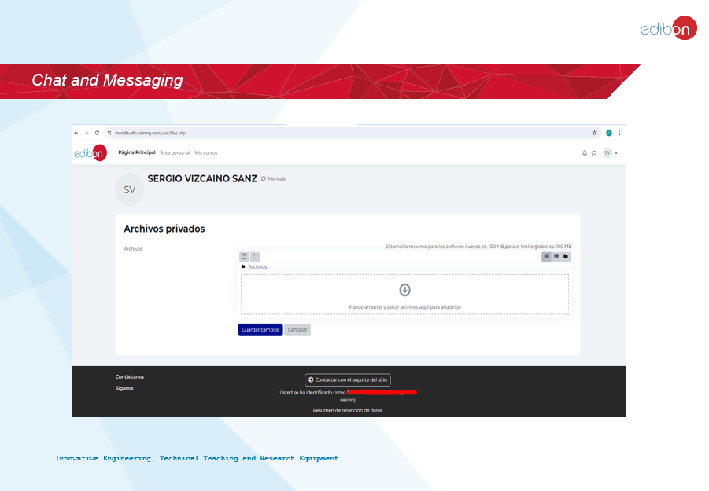
Erasmus+ Programme Key Action 2 Cooperation Partnerships
for Higher Education (KA220-HED)
Agreement number 2023-1-RO01-KA220-HED-000155412
European Network for Additive Manufacturing in Industrial Design for Ukrainian Context

Slide 17
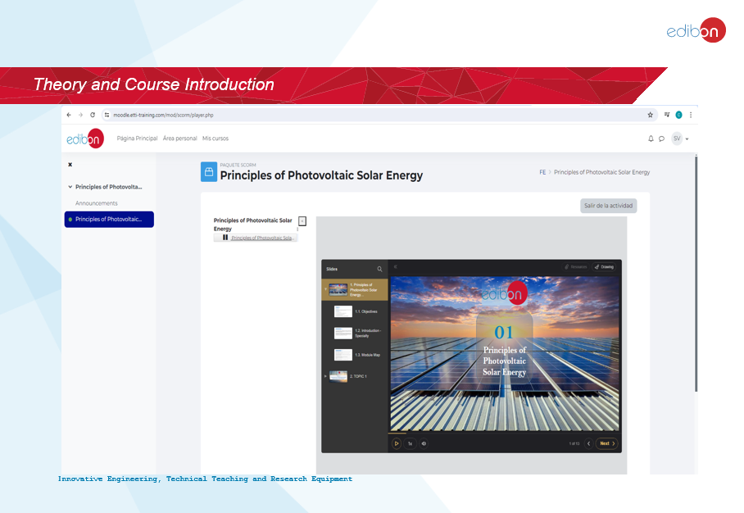
Erasmus+ Programme Key Action 2 Cooperation Partnerships
for Higher Education (KA220-HED)
Agreement number 2023-1-RO01-KA220-HED-000155412
European Network for Additive Manufacturing in Industrial Design for Ukrainian Context

Slide 18
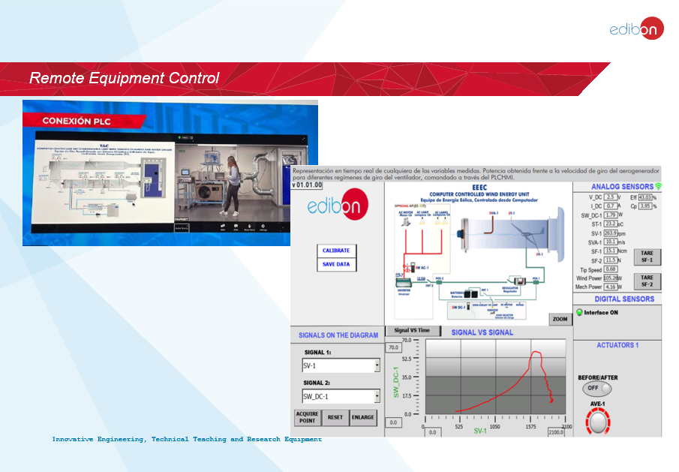
Erasmus+ Programme Key Action 2 Cooperation Partnerships
for Higher Education (KA220-HED)
Agreement number 2023-1-RO01-KA220-HED-000155412
European Network for Additive Manufacturing in Industrial Design for Ukrainian Context

Slide 19
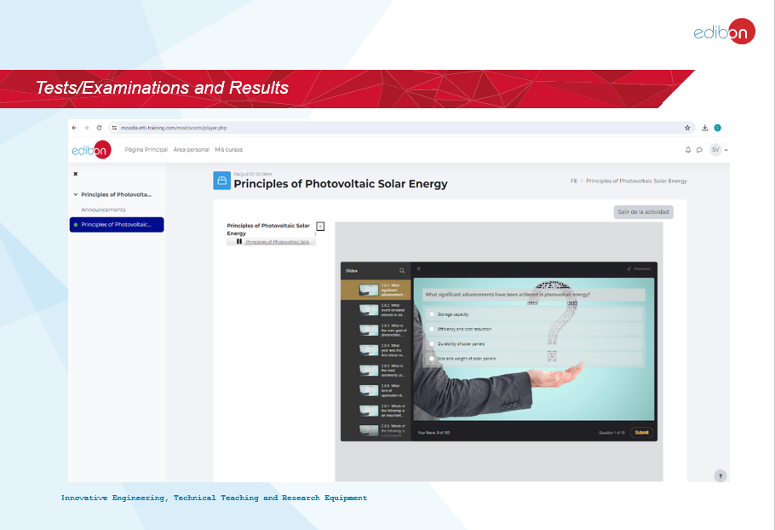
Erasmus+ Programme Key Action 2 Cooperation Partnerships
for Higher Education (KA220-HED)
Agreement number 2023-1-RO01-KA220-HED-000155412
European Network for Additive Manufacturing in Industrial Design for Ukrainian Context

Slide 20

Erasmus+ Programme Key Action 2 Cooperation Partnerships
for Higher Education (KA220-HED)
Agreement number 2023-1-RO01-KA220-HED-000155412
European Network for Additive Manufacturing in Industrial Design for Ukrainian Context

Slide 21

Erasmus+ Programme Key Action 2 Cooperation Partnerships
for Higher Education (KA220-HED)
Agreement number 2023-1-RO01-KA220-HED-000155412
European Network for Additive Manufacturing in Industrial Design for Ukrainian Context

Slide 22
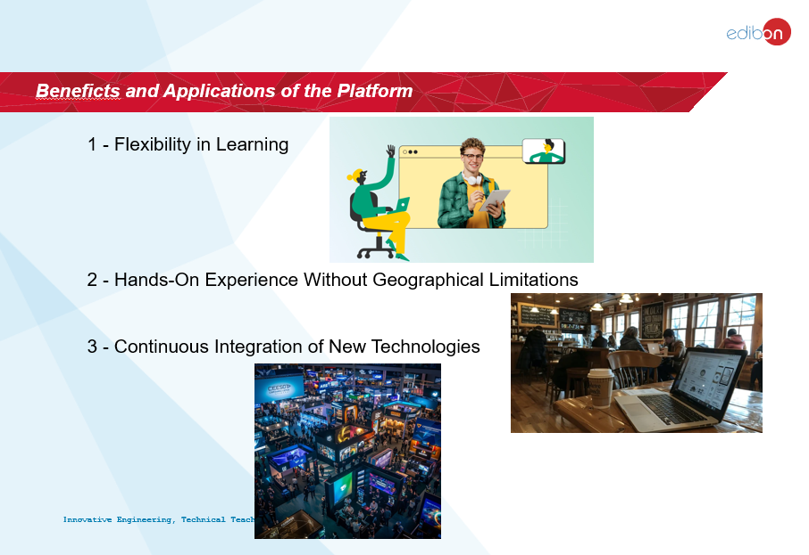
Erasmus+ Programme Key Action 2 Cooperation Partnerships
for Higher Education (KA220-HED)
Agreement number 2023-1-RO01-KA220-HED-000155412
European Network for Additive Manufacturing in Industrial Design for Ukrainian Context

Slide 23
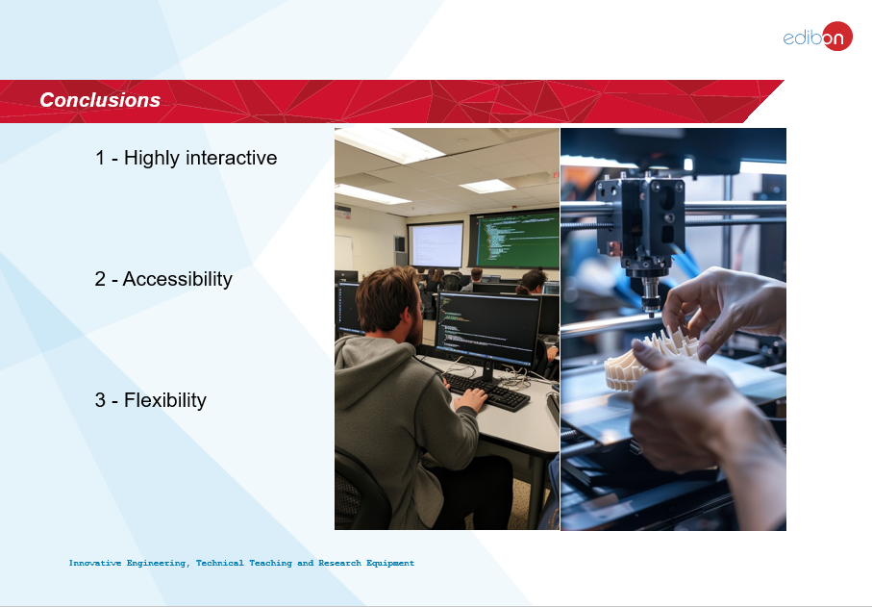
Erasmus+ Programme Key Action 2 Cooperation Partnerships
for Higher Education (KA220-HED)
Agreement number 2023-1-RO01-KA220-HED-000155412
European Network for Additive Manufacturing in Industrial Design for Ukrainian Context

Slide 24



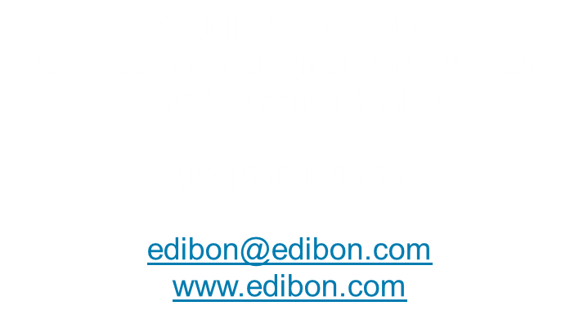
Erasmus+ Programme Key Action 2 Cooperation Partnerships
for Higher Education (KA220-HED)
Agreement number 2023-1-RO01-KA220-HED-000155412
European Network for Additive Manufacturing in Industrial Design for Ukrainian Context

